Slide 1

Performance, Space and Spirituality: Music and Ori-oke Christianity in Nigeria
Toyin Samuel Ajose
Department of Music
University of Ibadan, Nigeria
ts.ajose@ui.edu.ng

Slide 2
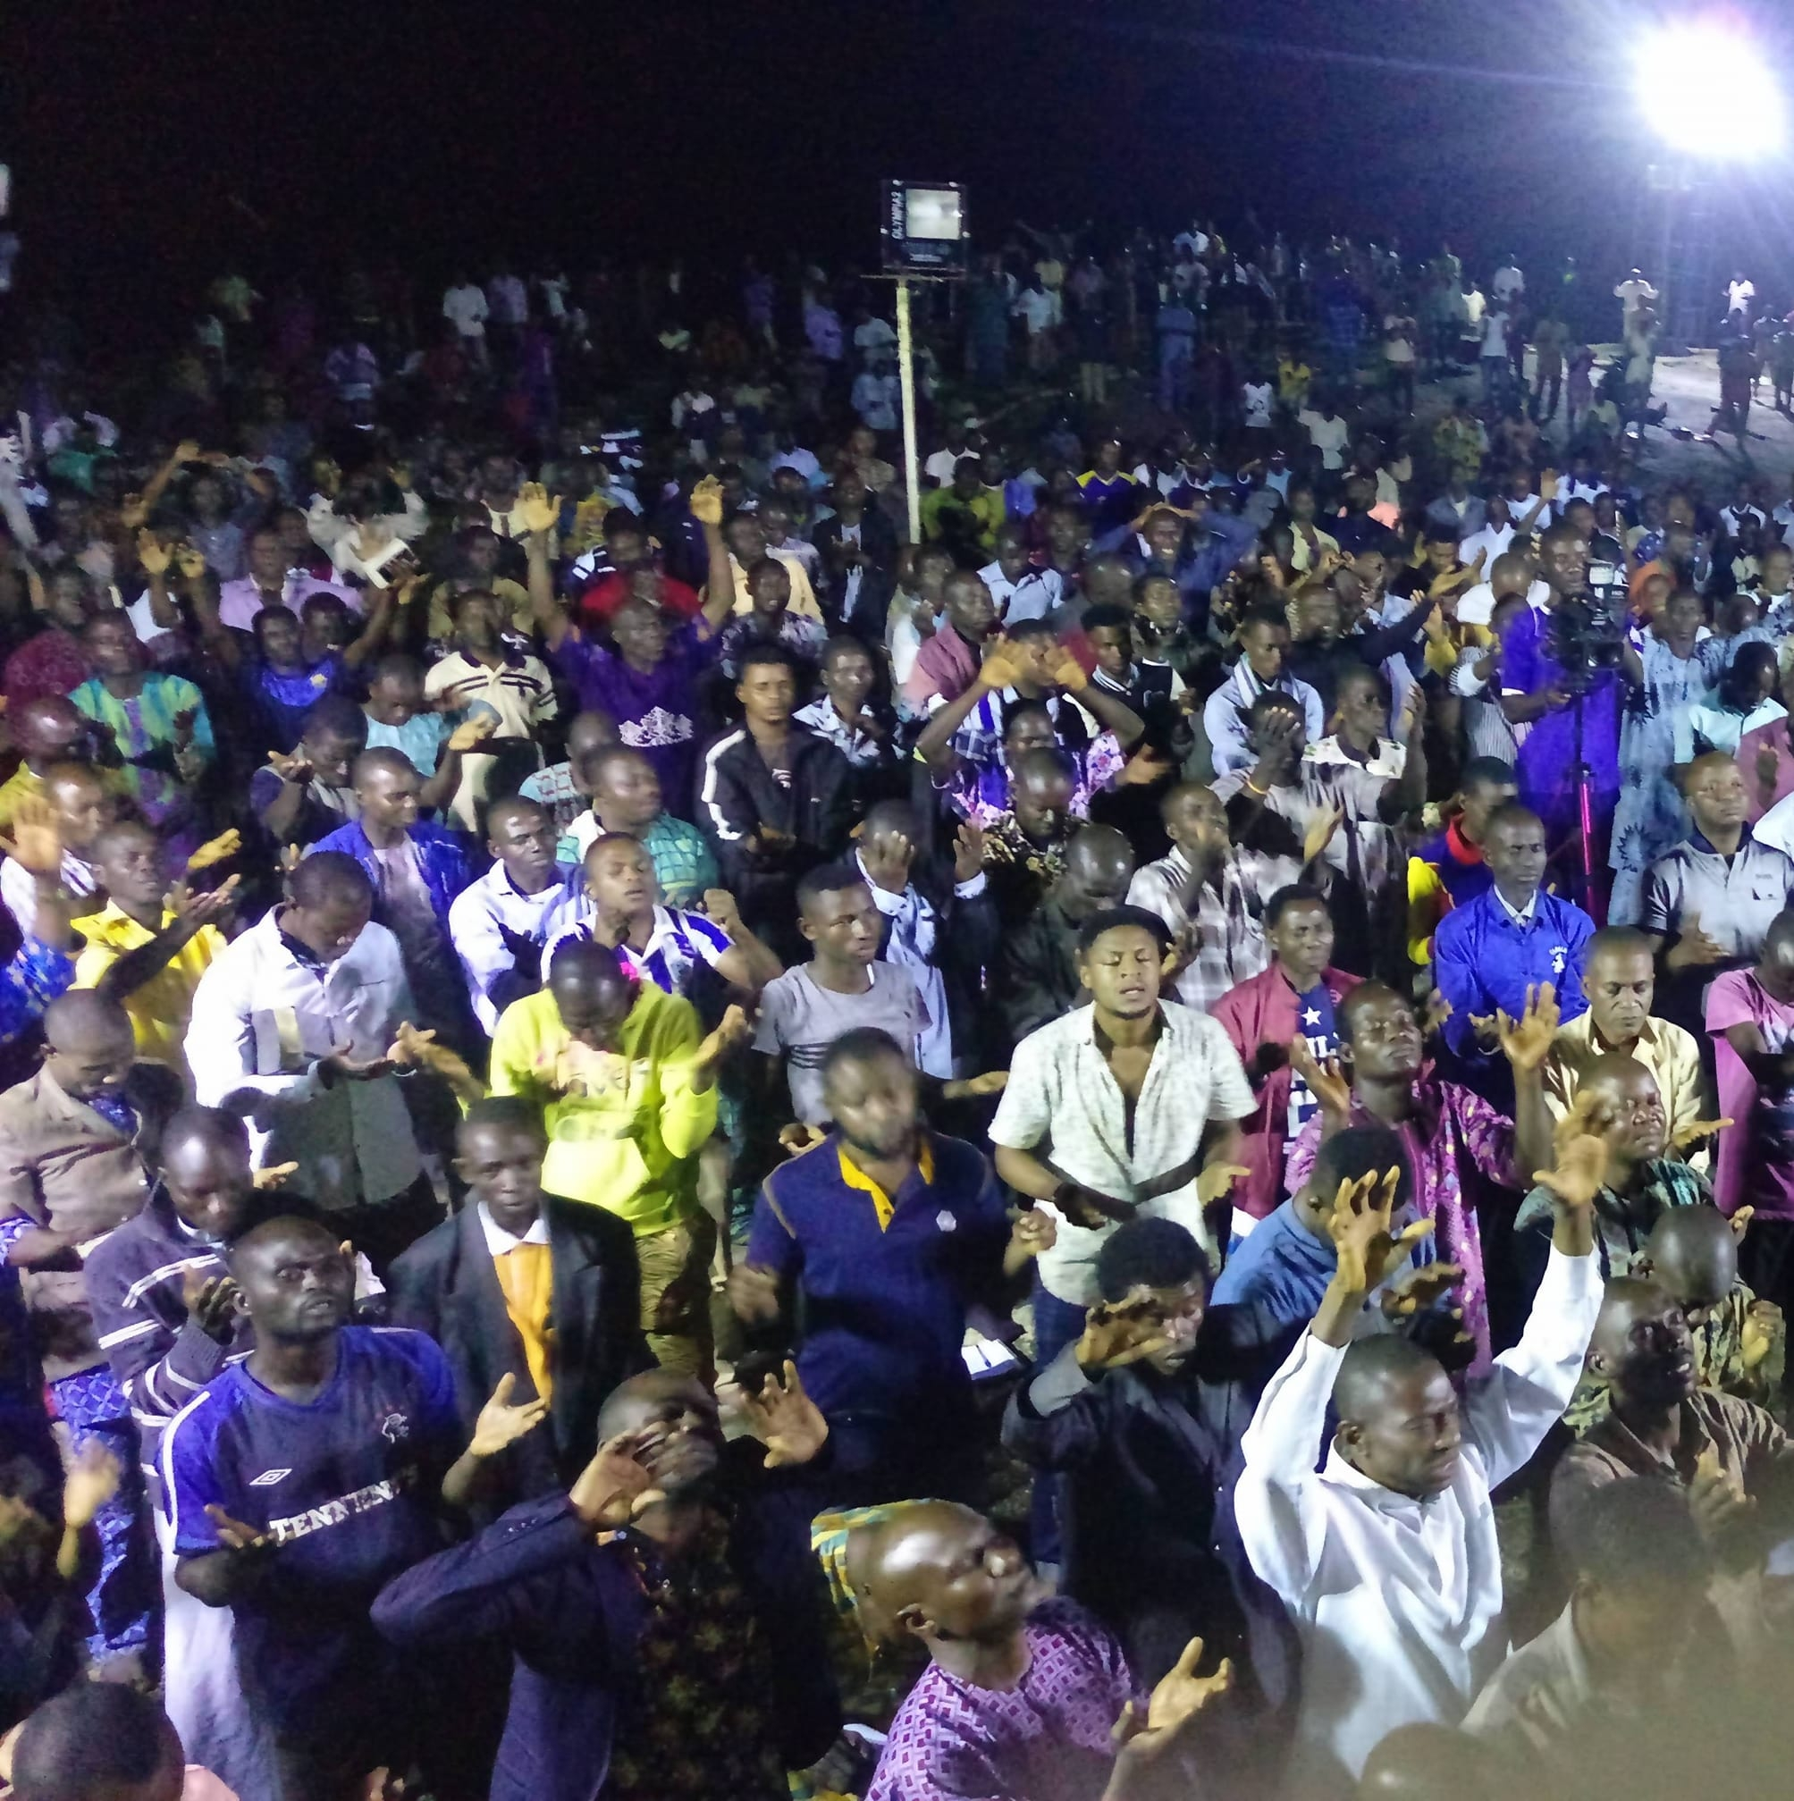
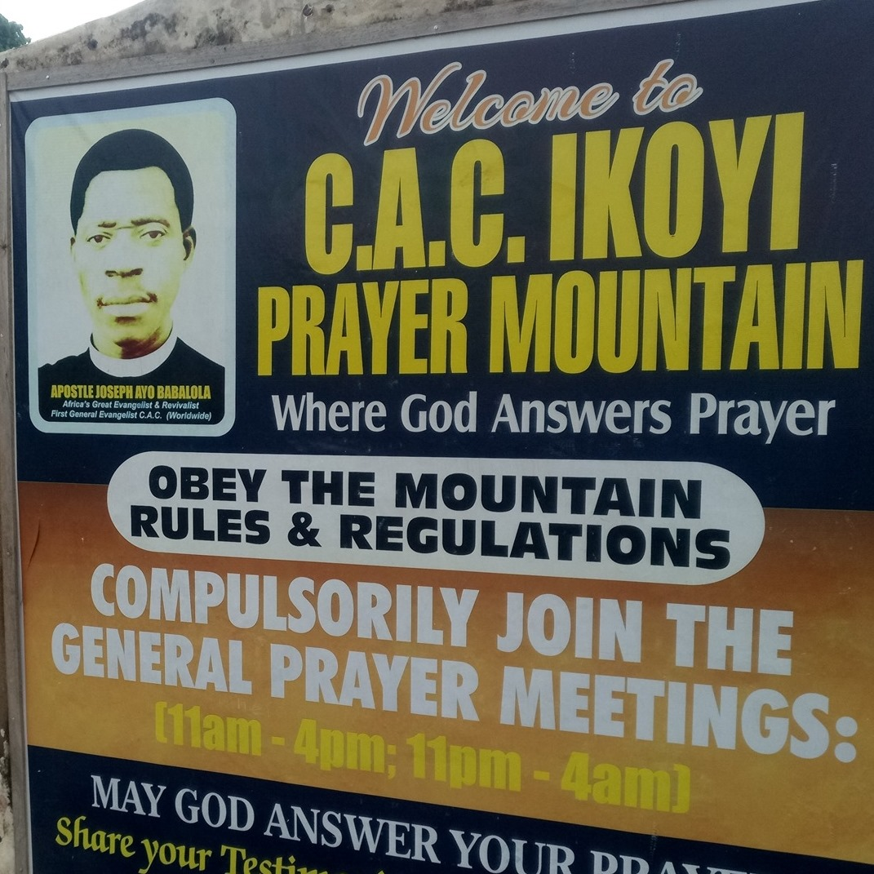
“Sacred sites mean something more” (Coomans et al. 2012: 10)
Is my wife on the mountain?

Slide 3
Review of Literature
Definition and conceptualization of sacred space (Otto 1946; Eliade 1959; Koivuguu 2009)
Manifestations in local and global settings (Friedland and Hecht 1991; Jung 2002; Okyere 2012; Ogundayo and Adekunle 2019)
Nuances and ambivalences (Heynickx et al. 1992; Rosati, 2009; Ball 2012)
Significance in different religious and social contexts (Davies 1994; Aitpaeva 2009; Bastin 2012)
Ritual site for symbolic performances, a significant place that answers people’s questions (Chidester and Linenthal, 1995)
Ori-oke is underexplored in African/Nigerian sacred geographies as an “energetic zone” where people negotiate vitally necessary conditions” (Aitpaeva 2009)

Slide 4
Review of literature
African Spirituality and sacred spaces (Parrinder 1954; Mbiti 1969, 1975; Olupona 1991, 2000; Gumo et al 2009; Ayegboyin 2010; Okpu 2017, Ogundayo and Adekunle 2019)
Prayer mountain in African lived Christianity (Ayegboyin 2005; Alabi 2012; Okyere 2012, 2018; Yaovi et al. 2018; Samuel and Ajose 2018, Gbadegesin 2019)
Sight or sound in the study of religion? (Chidester 1992; Schmidt 2002; Hacket 2012; Kasfelt 2020)
Music in Nigerian/Yoruba Christianity ( Ojo 1998; Adedeji 2004, 2012; Loko 2012, Owoaje 2014; Brennan 2018; Ajose 2020

Slide 5
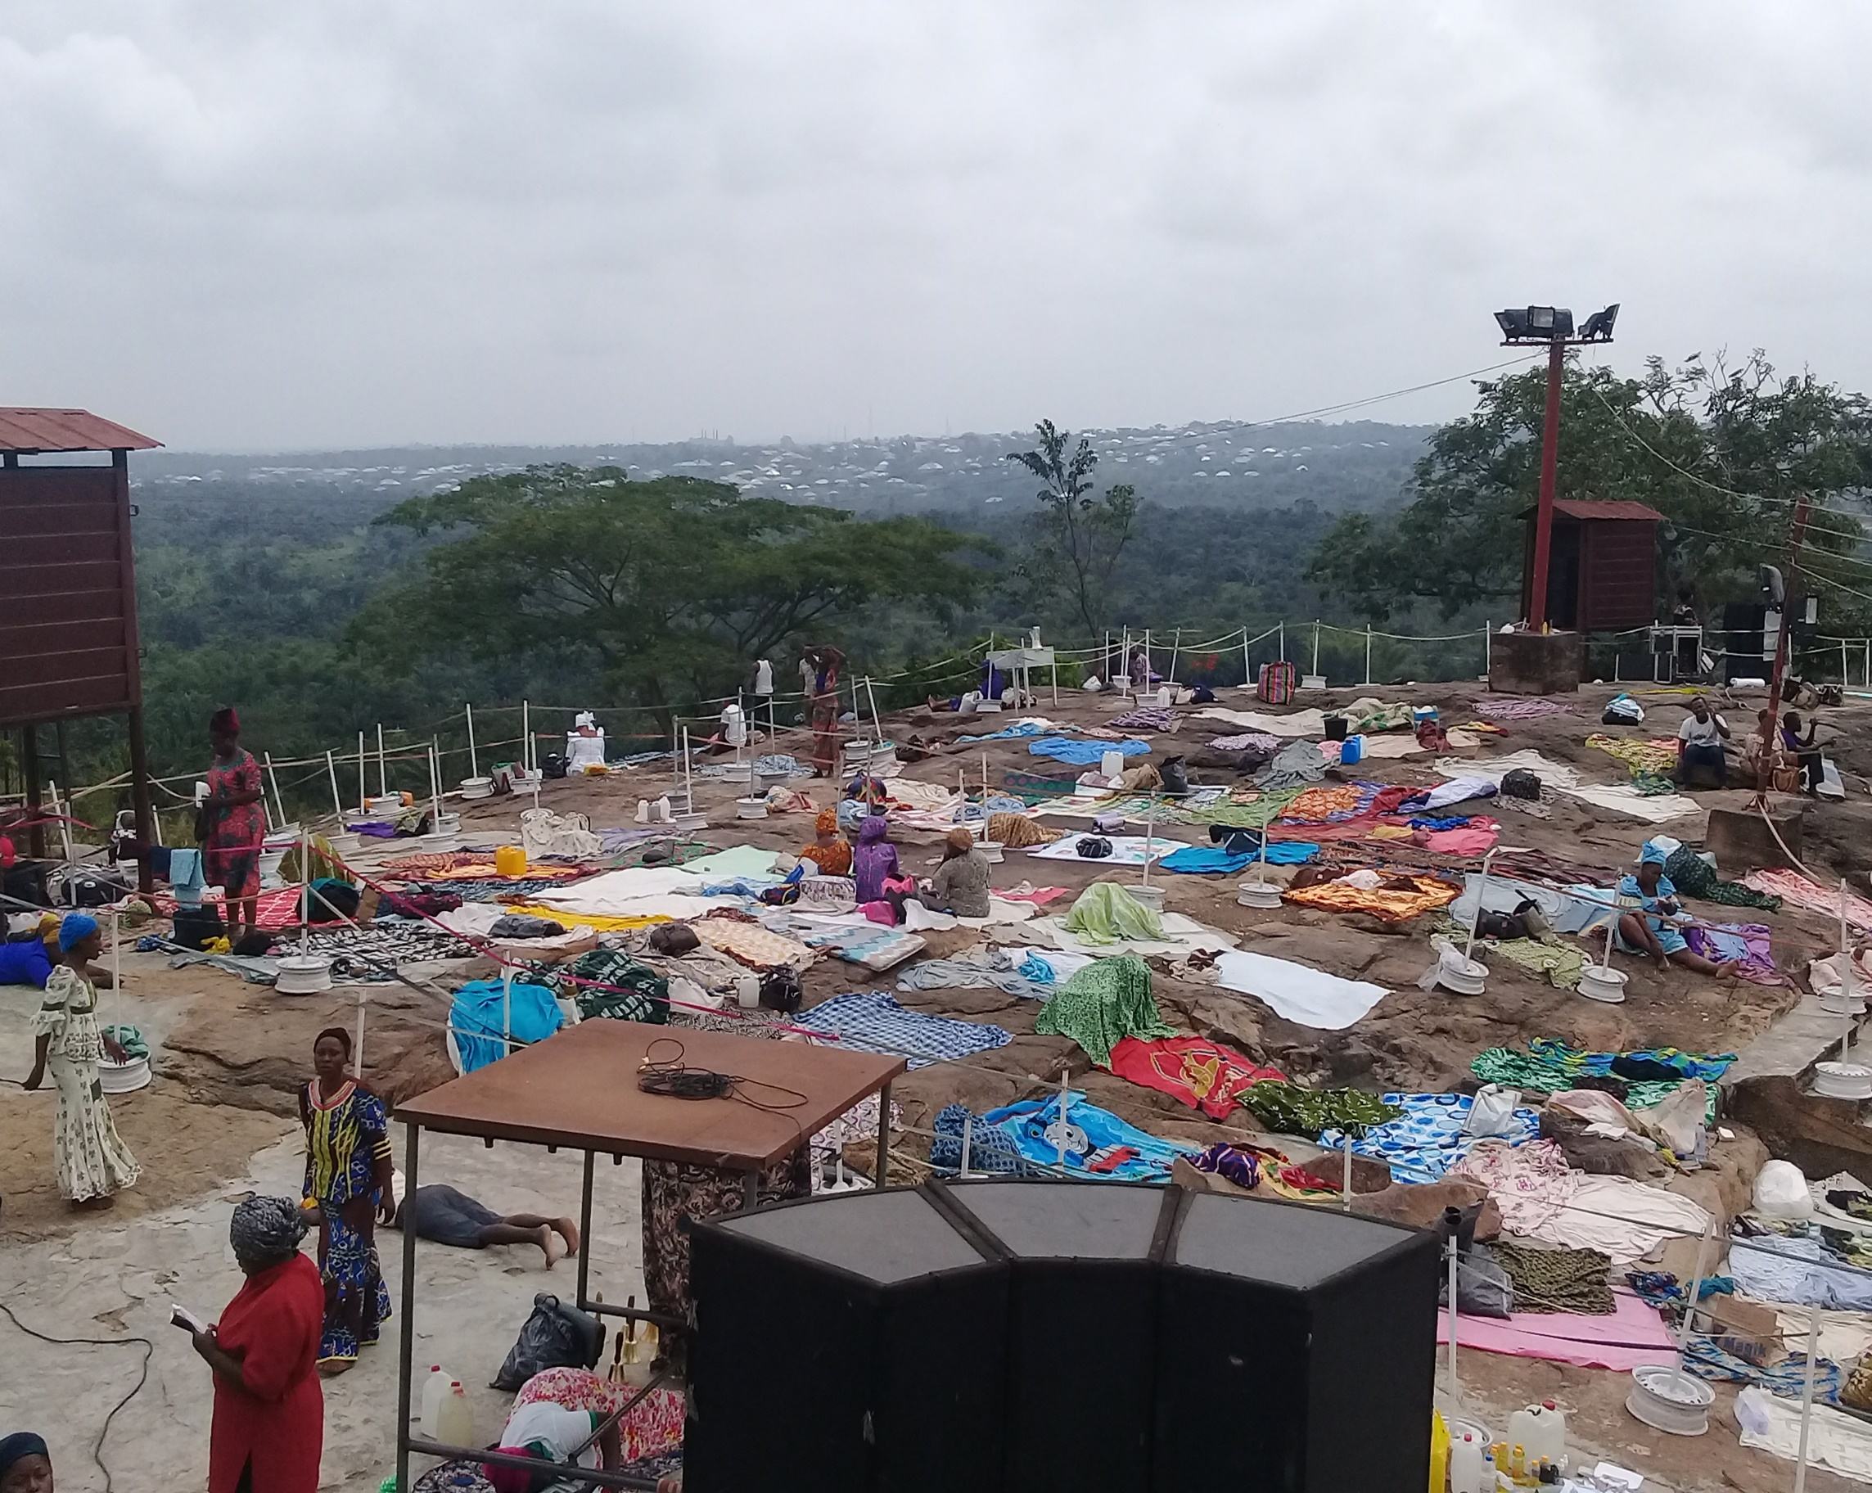
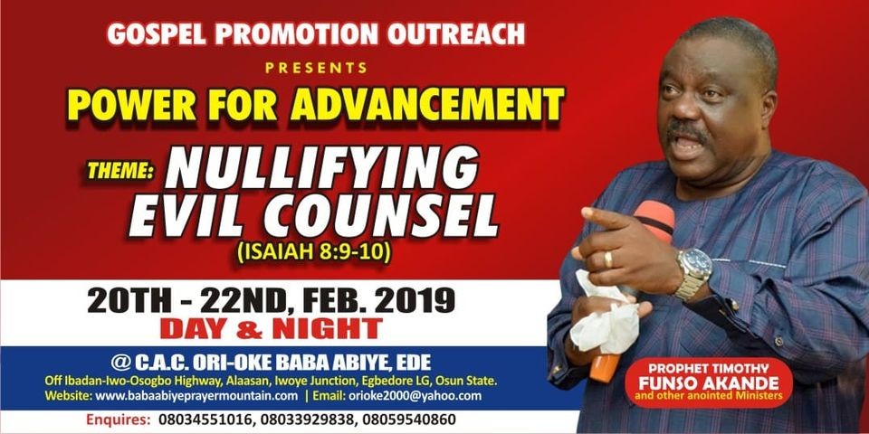
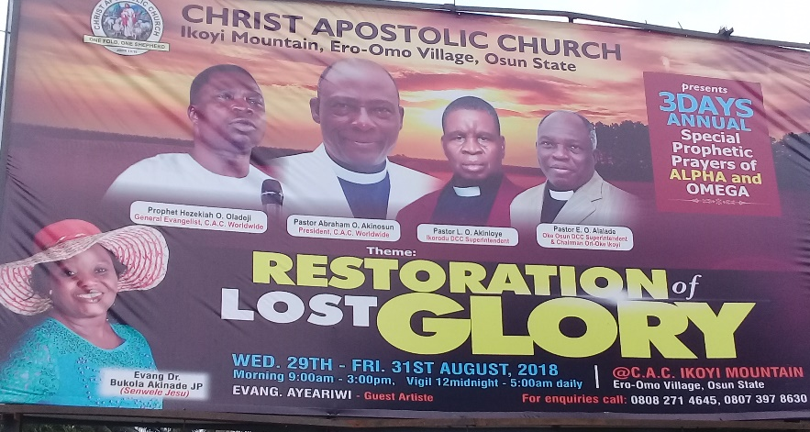

“We are here to fight”: negotiating welfare through warfare
Singing: Fire from above enter my life. Holy Ghost Fire!!!
Prayer: “Father, I am suffering because I am powerless. Rekindle the fire of the Holy Spirit in me. I want to be powerful!”

Slide 6
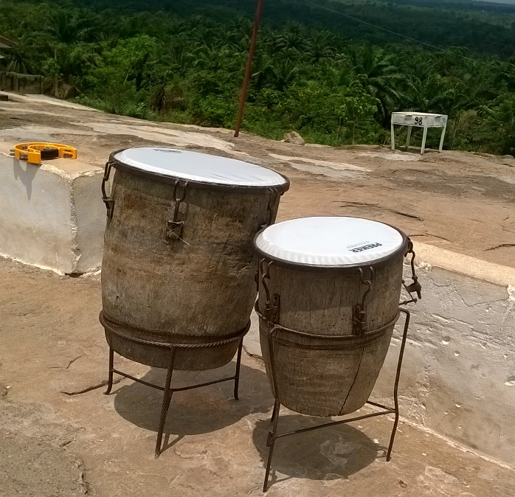
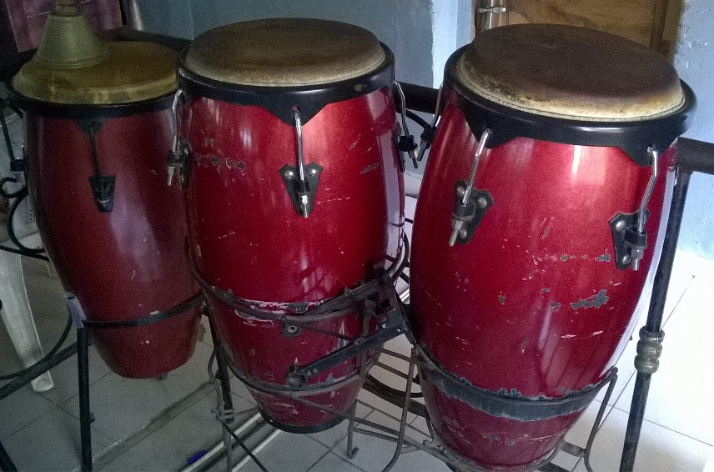
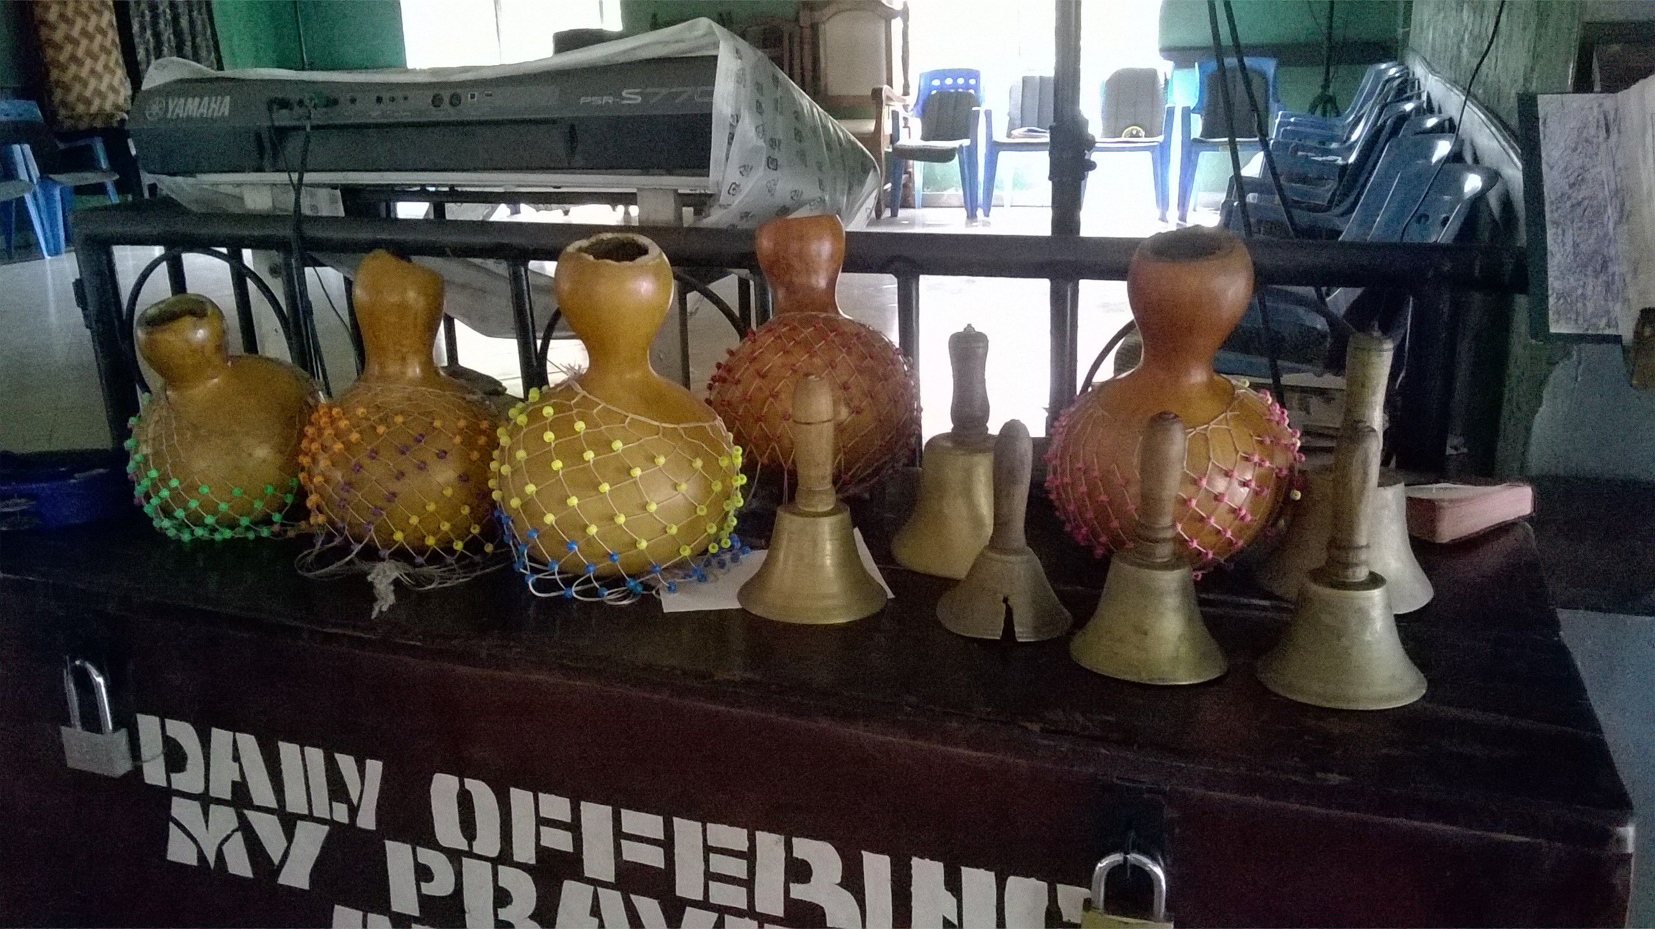
Analyzing Ori-oke performance space
Fast tempo music heightens prayers
Indigenous percussions on Ori-oke as an archetype of military band
Drums and bells - paradox of violence and victory (Rom 2020)
Agogo Igbala/Isegun (bell of victory)
Spontaneous compositions, divinely inspired
Call and response, short verse form, folk tunes, pentatonic scale, parallel harmony
Ori-oke populating (Yoruba) Christian music repertoire

Slide 7
“Prayer is the soup and music (song) is the spice”
Music, prayer laced with social commentaries (Ajose 2018, 2020)
The mundane is present in the sacred: ‘gingering’ the spirit
“It is not easy to pray…. Prayer involves the whole of your body and there is the tendency to want to get tired especially during all-night prayers. As we lead prayers and we notice that the people are becoming tired, we throw in a song to ginger their spirit” (Interview: Evangelist Mrs. Esther, prayer/song leader, Ori-oke Baba Abiye, March 8, 2019)
Music and prayers as ‘stimulants’ and ‘condiments’ in spiritual labour
Performance, spirituality and well-being- “dance away your sorrows”

Slide 8
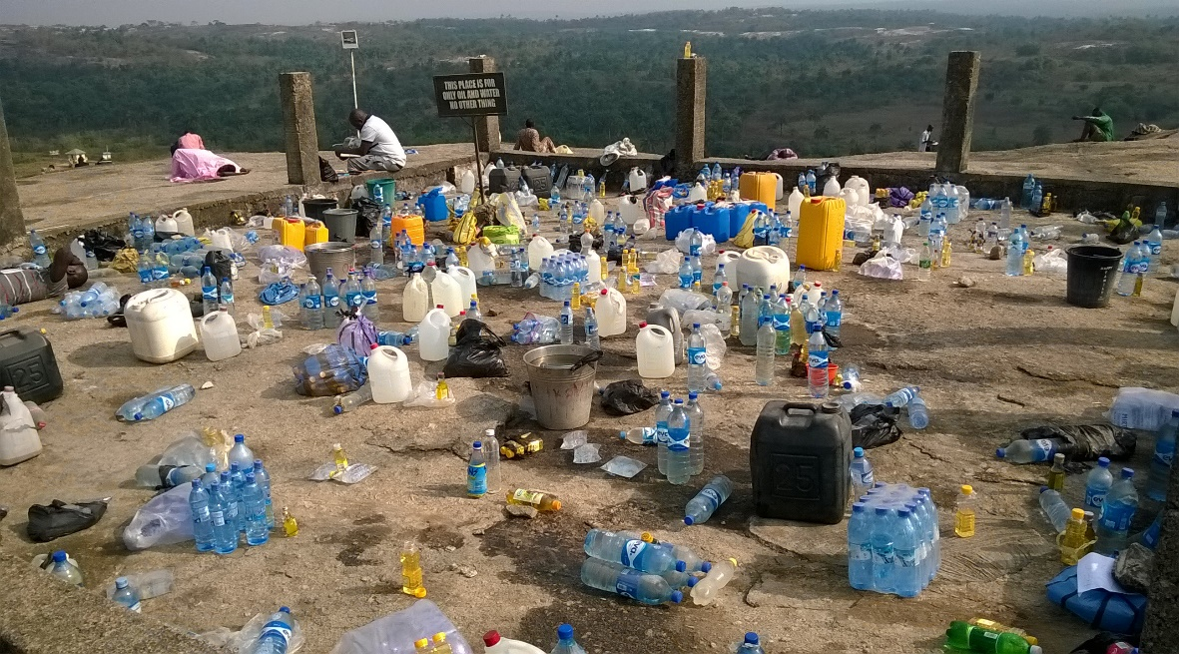
Conclusion
Religion is crucial for understanding humanity in Africa
Sacred spaces like Ori-oke mean something more to people in Nigeria
Ori-oke performance space-music and prayer-offers deeper insight into the everyday socio-economic aspirations of people in postcolonial Nigeria and Africa

Slide 9
THANK YOU!!!

