Slide 1

ROOM HIRE

Slide 2
Host Your Event at SOAS University
With versatile spaces across three central London locations, SOAS offers flexible event solutions at competitive rates.
All seminar rooms feature natural daylight and state-of-the-art AV. We provide freshly prepared, seasonal organic catering, with a variety of packages to suit your needs.
From high-profile visits by dignitaries and heads of state to intimate community gatherings, our expert team manages every detail to ensure your event runs seamlessly.
SOAS University
offers flexible meeting and event solutions!

Slide 3
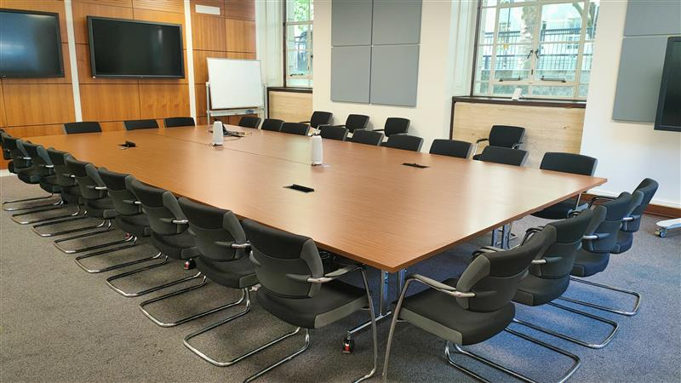
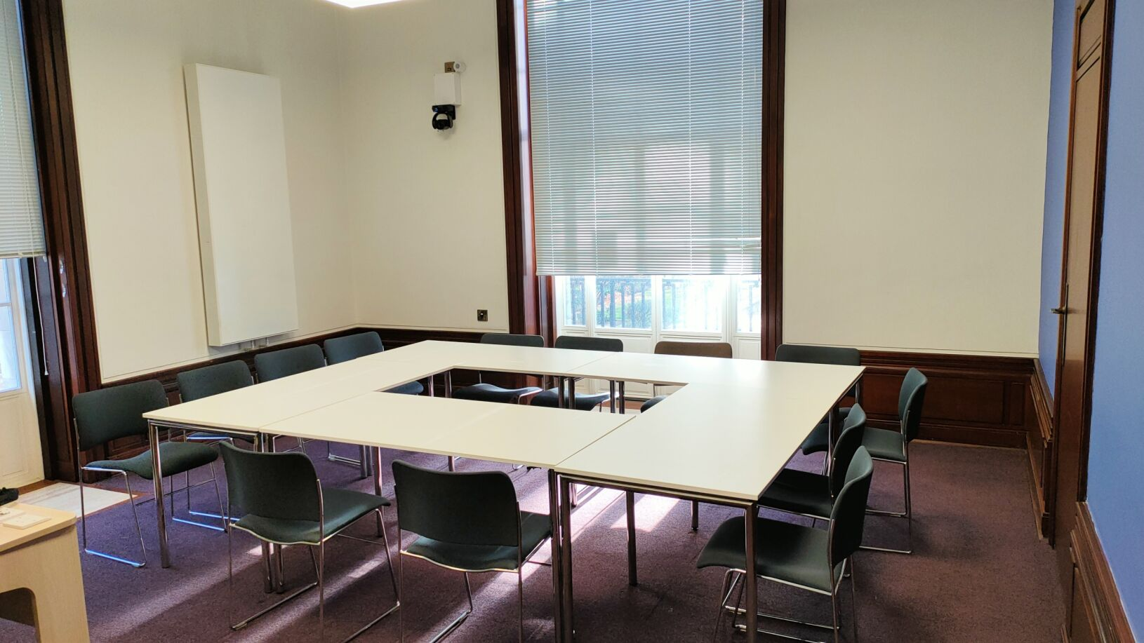
MEETING ROOMS (5 to 20 guests)
TAGS:
MEETING ROOM
WORKSHOP
WORK SESSION
GROUP WORK
COACHING
TRAINING ROOM
PRESENTATION
PLANNING SESSION
INTERVIEW ROOM
A vibrant meeting room / collaborative space for small group and round table discussions with a capacity up to 20 guests. Fully equipped with a display screen with laptop HDMI interface ideal for Zoom/other video communication technology. In addition; the room also includes: a whiteboard, guest Wi-Fi access as well as disabled access.
Catering / flipboard available upon request.
AV EQUIPMENT IN ROOM: display screen, HDMI laptop interface, speakers

Slide 4
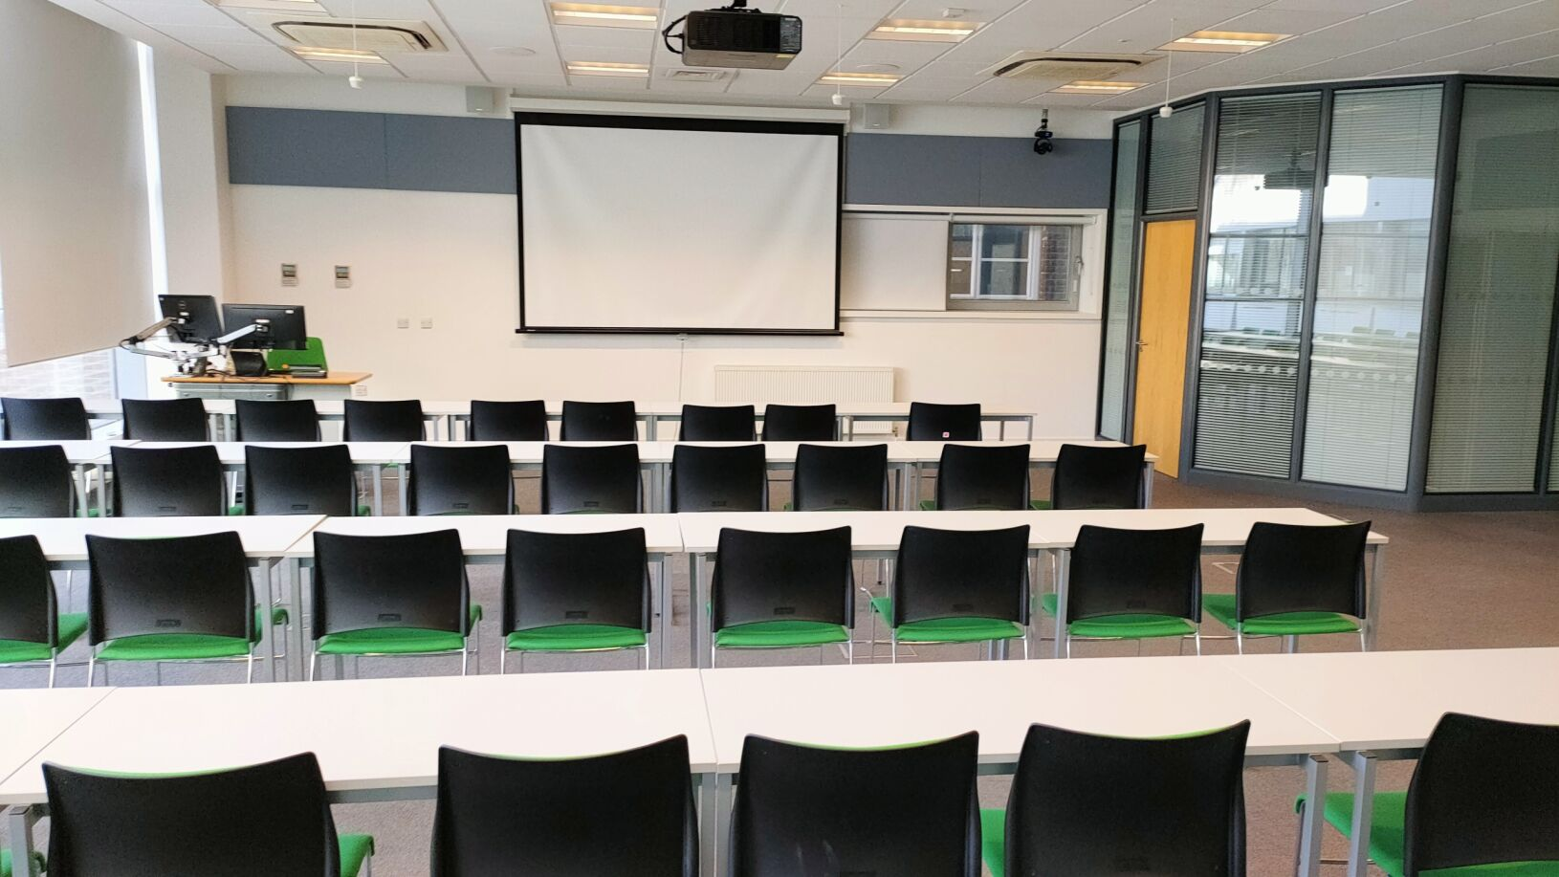
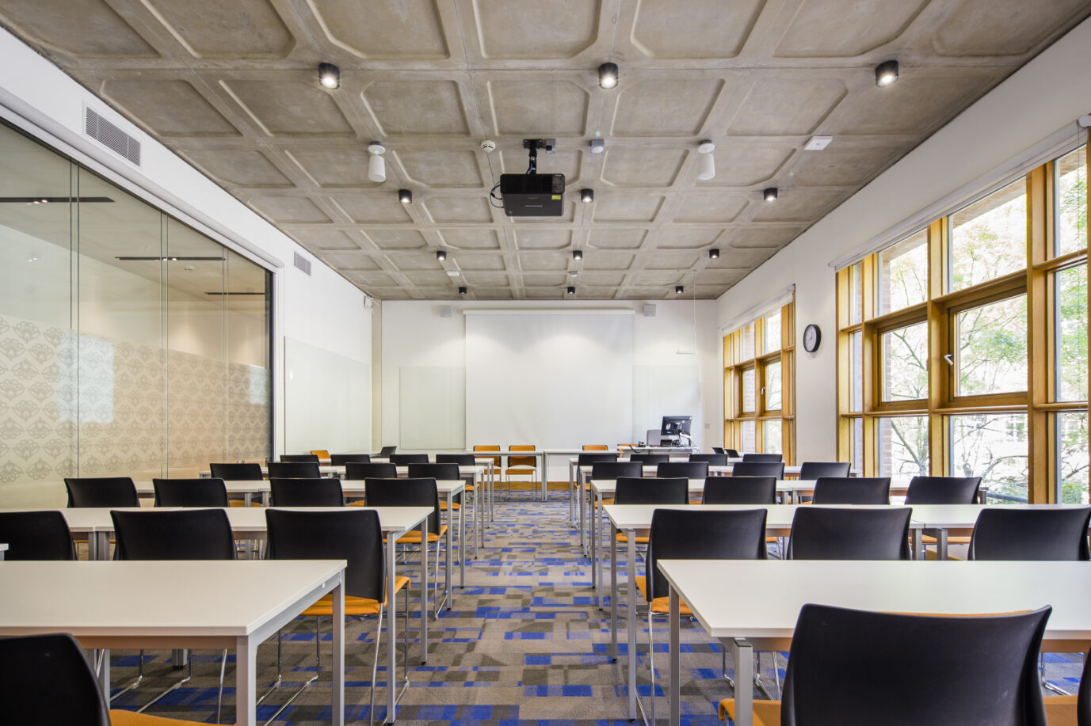
SEMINAR ROOMS (20 to 60 guests)
TAGS:
PRESENTATION
WORKSHOP
WORK SESSION
GROUP WORK
COACHING
TRAINING ROOM
PLANNING SESSION
CREATIVE SPACE
ANNUAL GENERAL MEETING
SUMMIT
FORUM
SPEAKER PANNEL
PRESS CONFERENCE
CONFERENCE VENUE
AUDITORIUM
CONFERENCE CENTER
A vibrant classroom for medium sized, highly interactive and engaging classes with a capacity up to 60 guests. The room is carefully designed that microphone is not needed for conducting face-to-face class while there are facilities sufficient for conducting a hybrid class. The room also includes: a whiteboard, guest Wi-Fi access as well as disabled access.
Catering / flipboard available upon request.
AV EQUIPMENT IN ROOM: HD laser projector / display screen, ceiling camera, USB microphone for online teaching, laptop HDMI interface, speakers

Slide 5
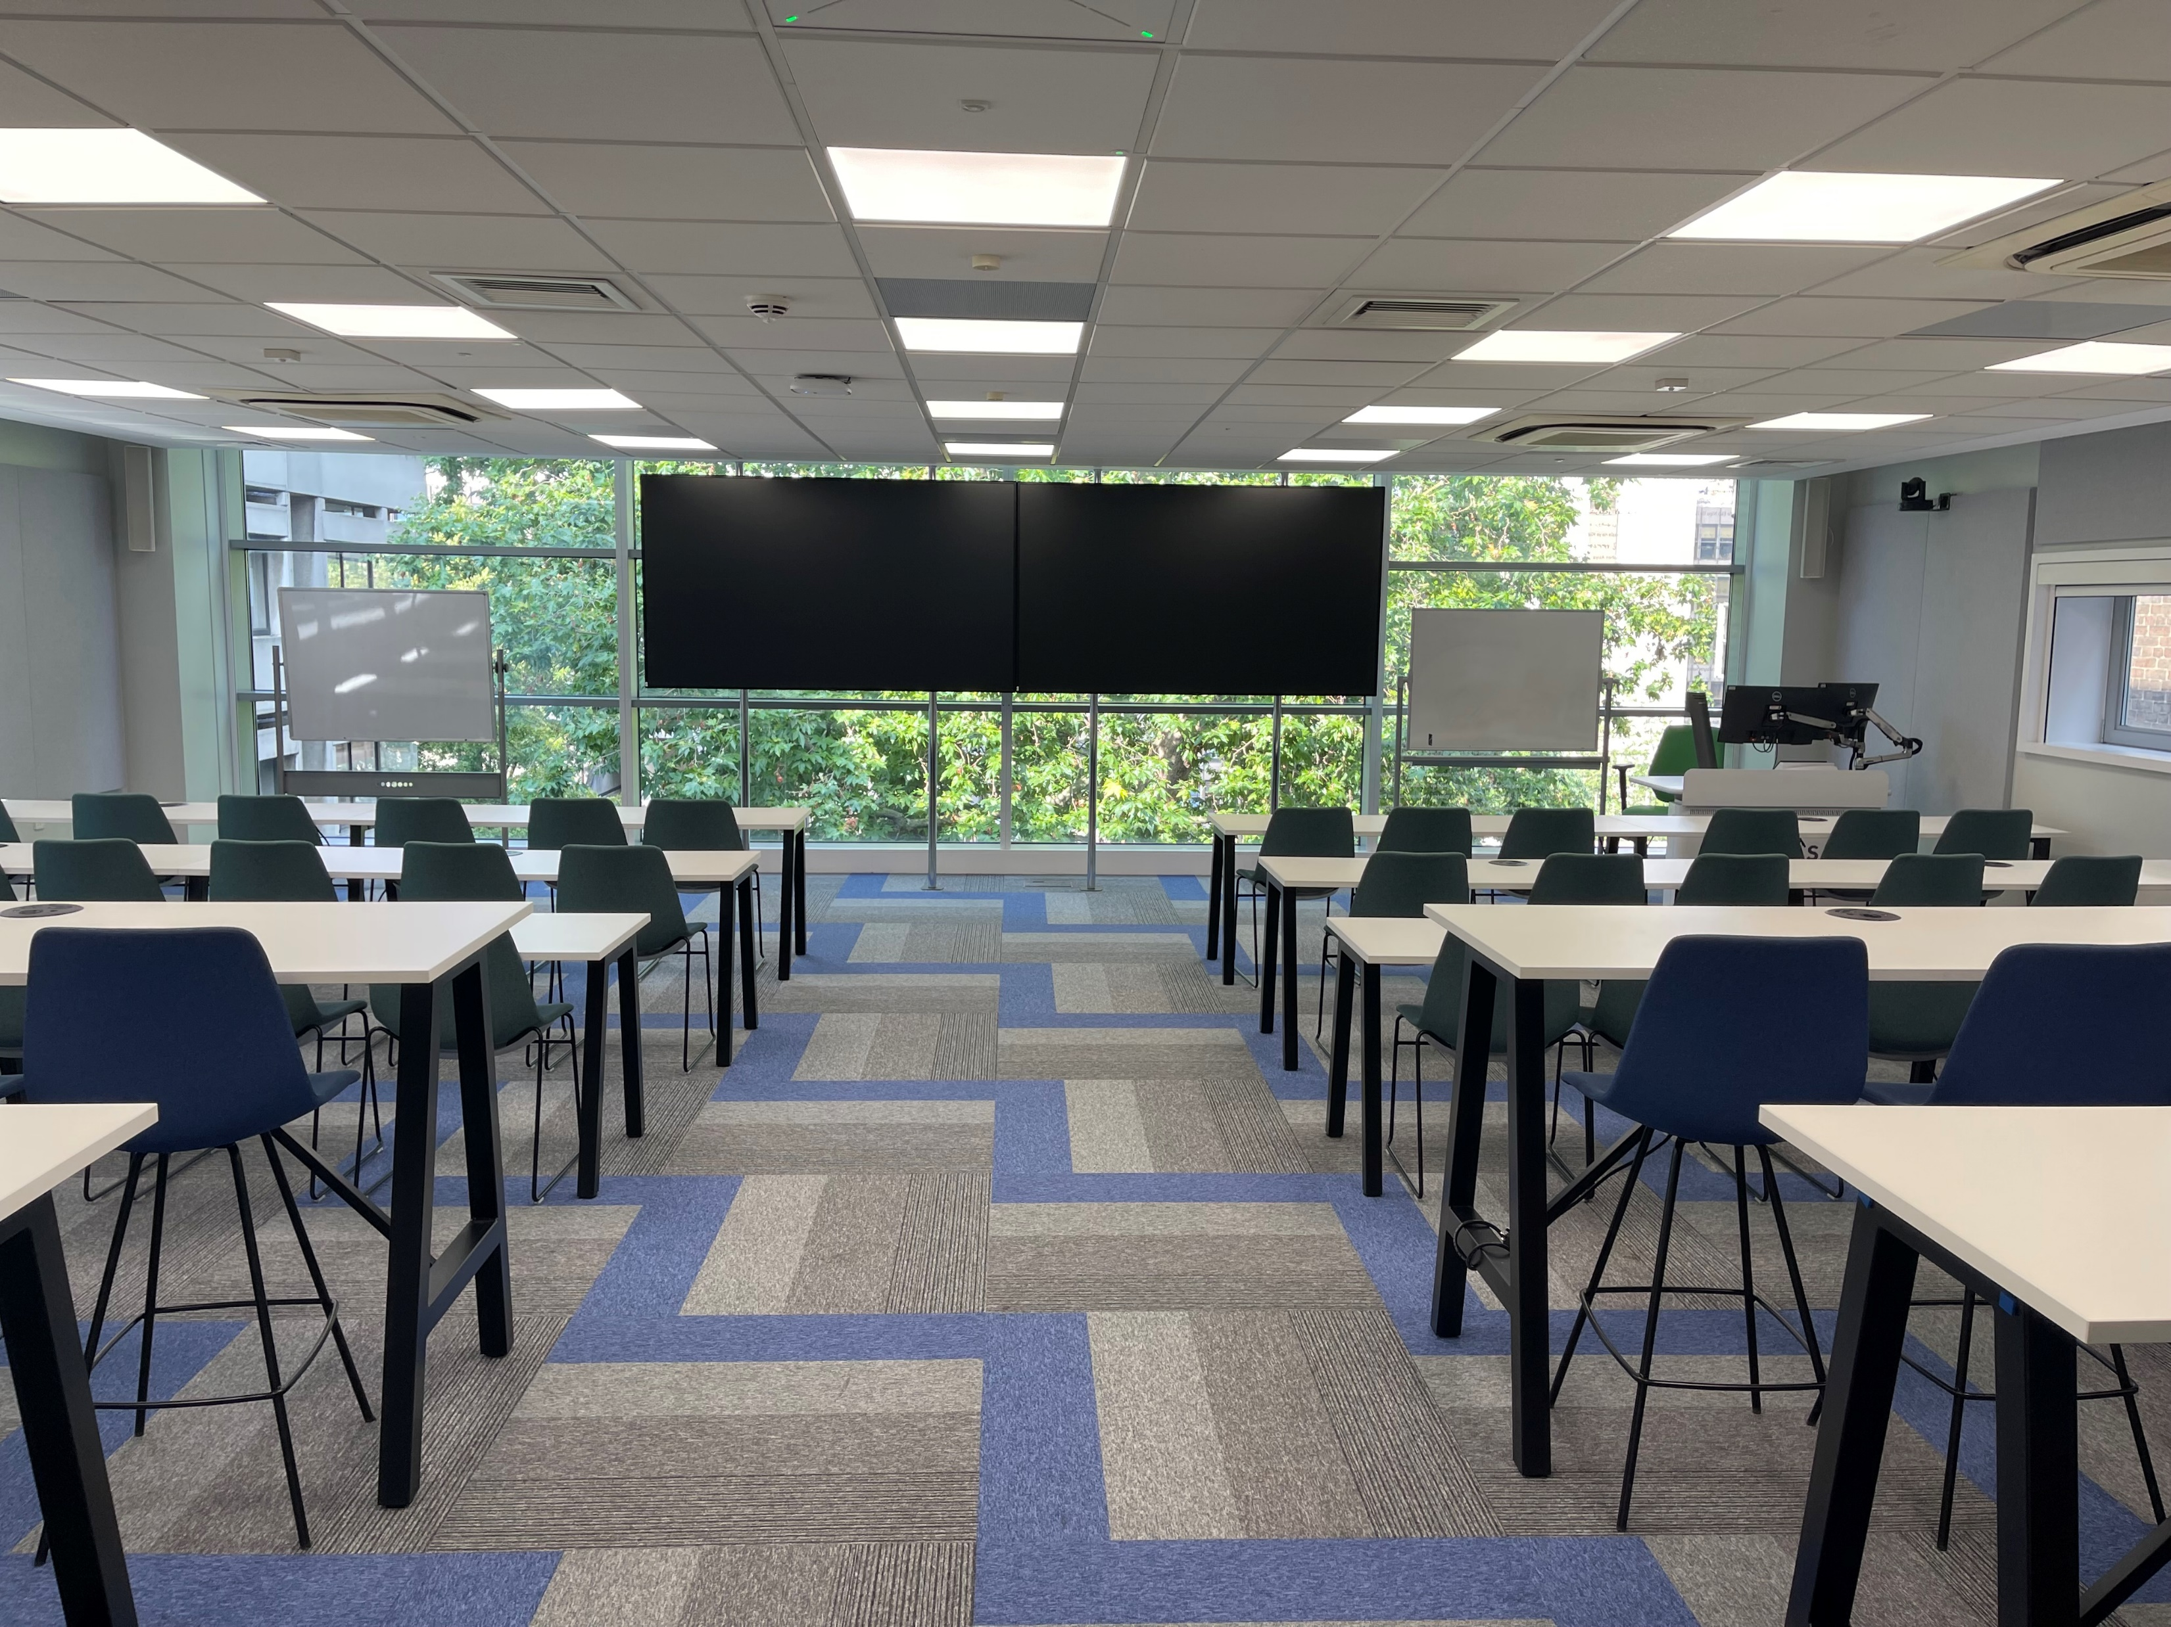

Slide 6
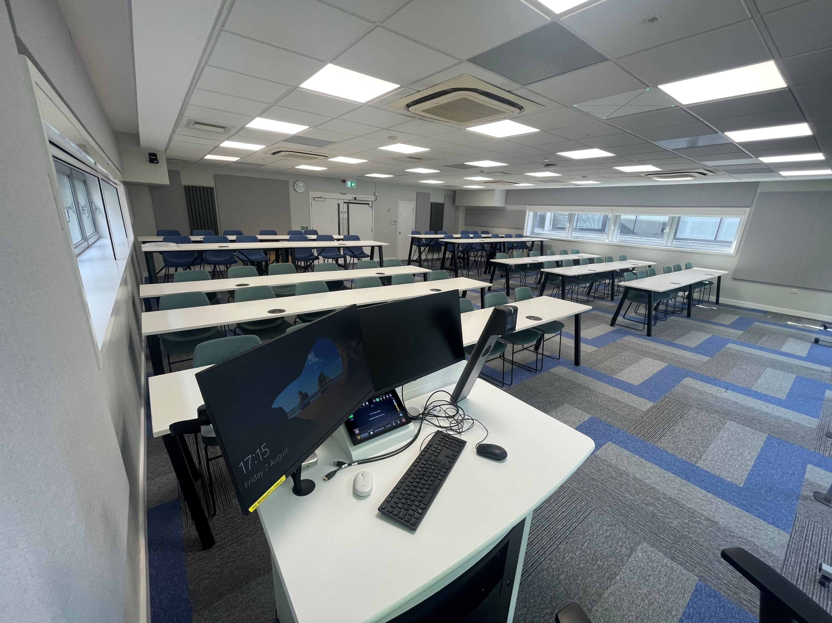

Slide 7
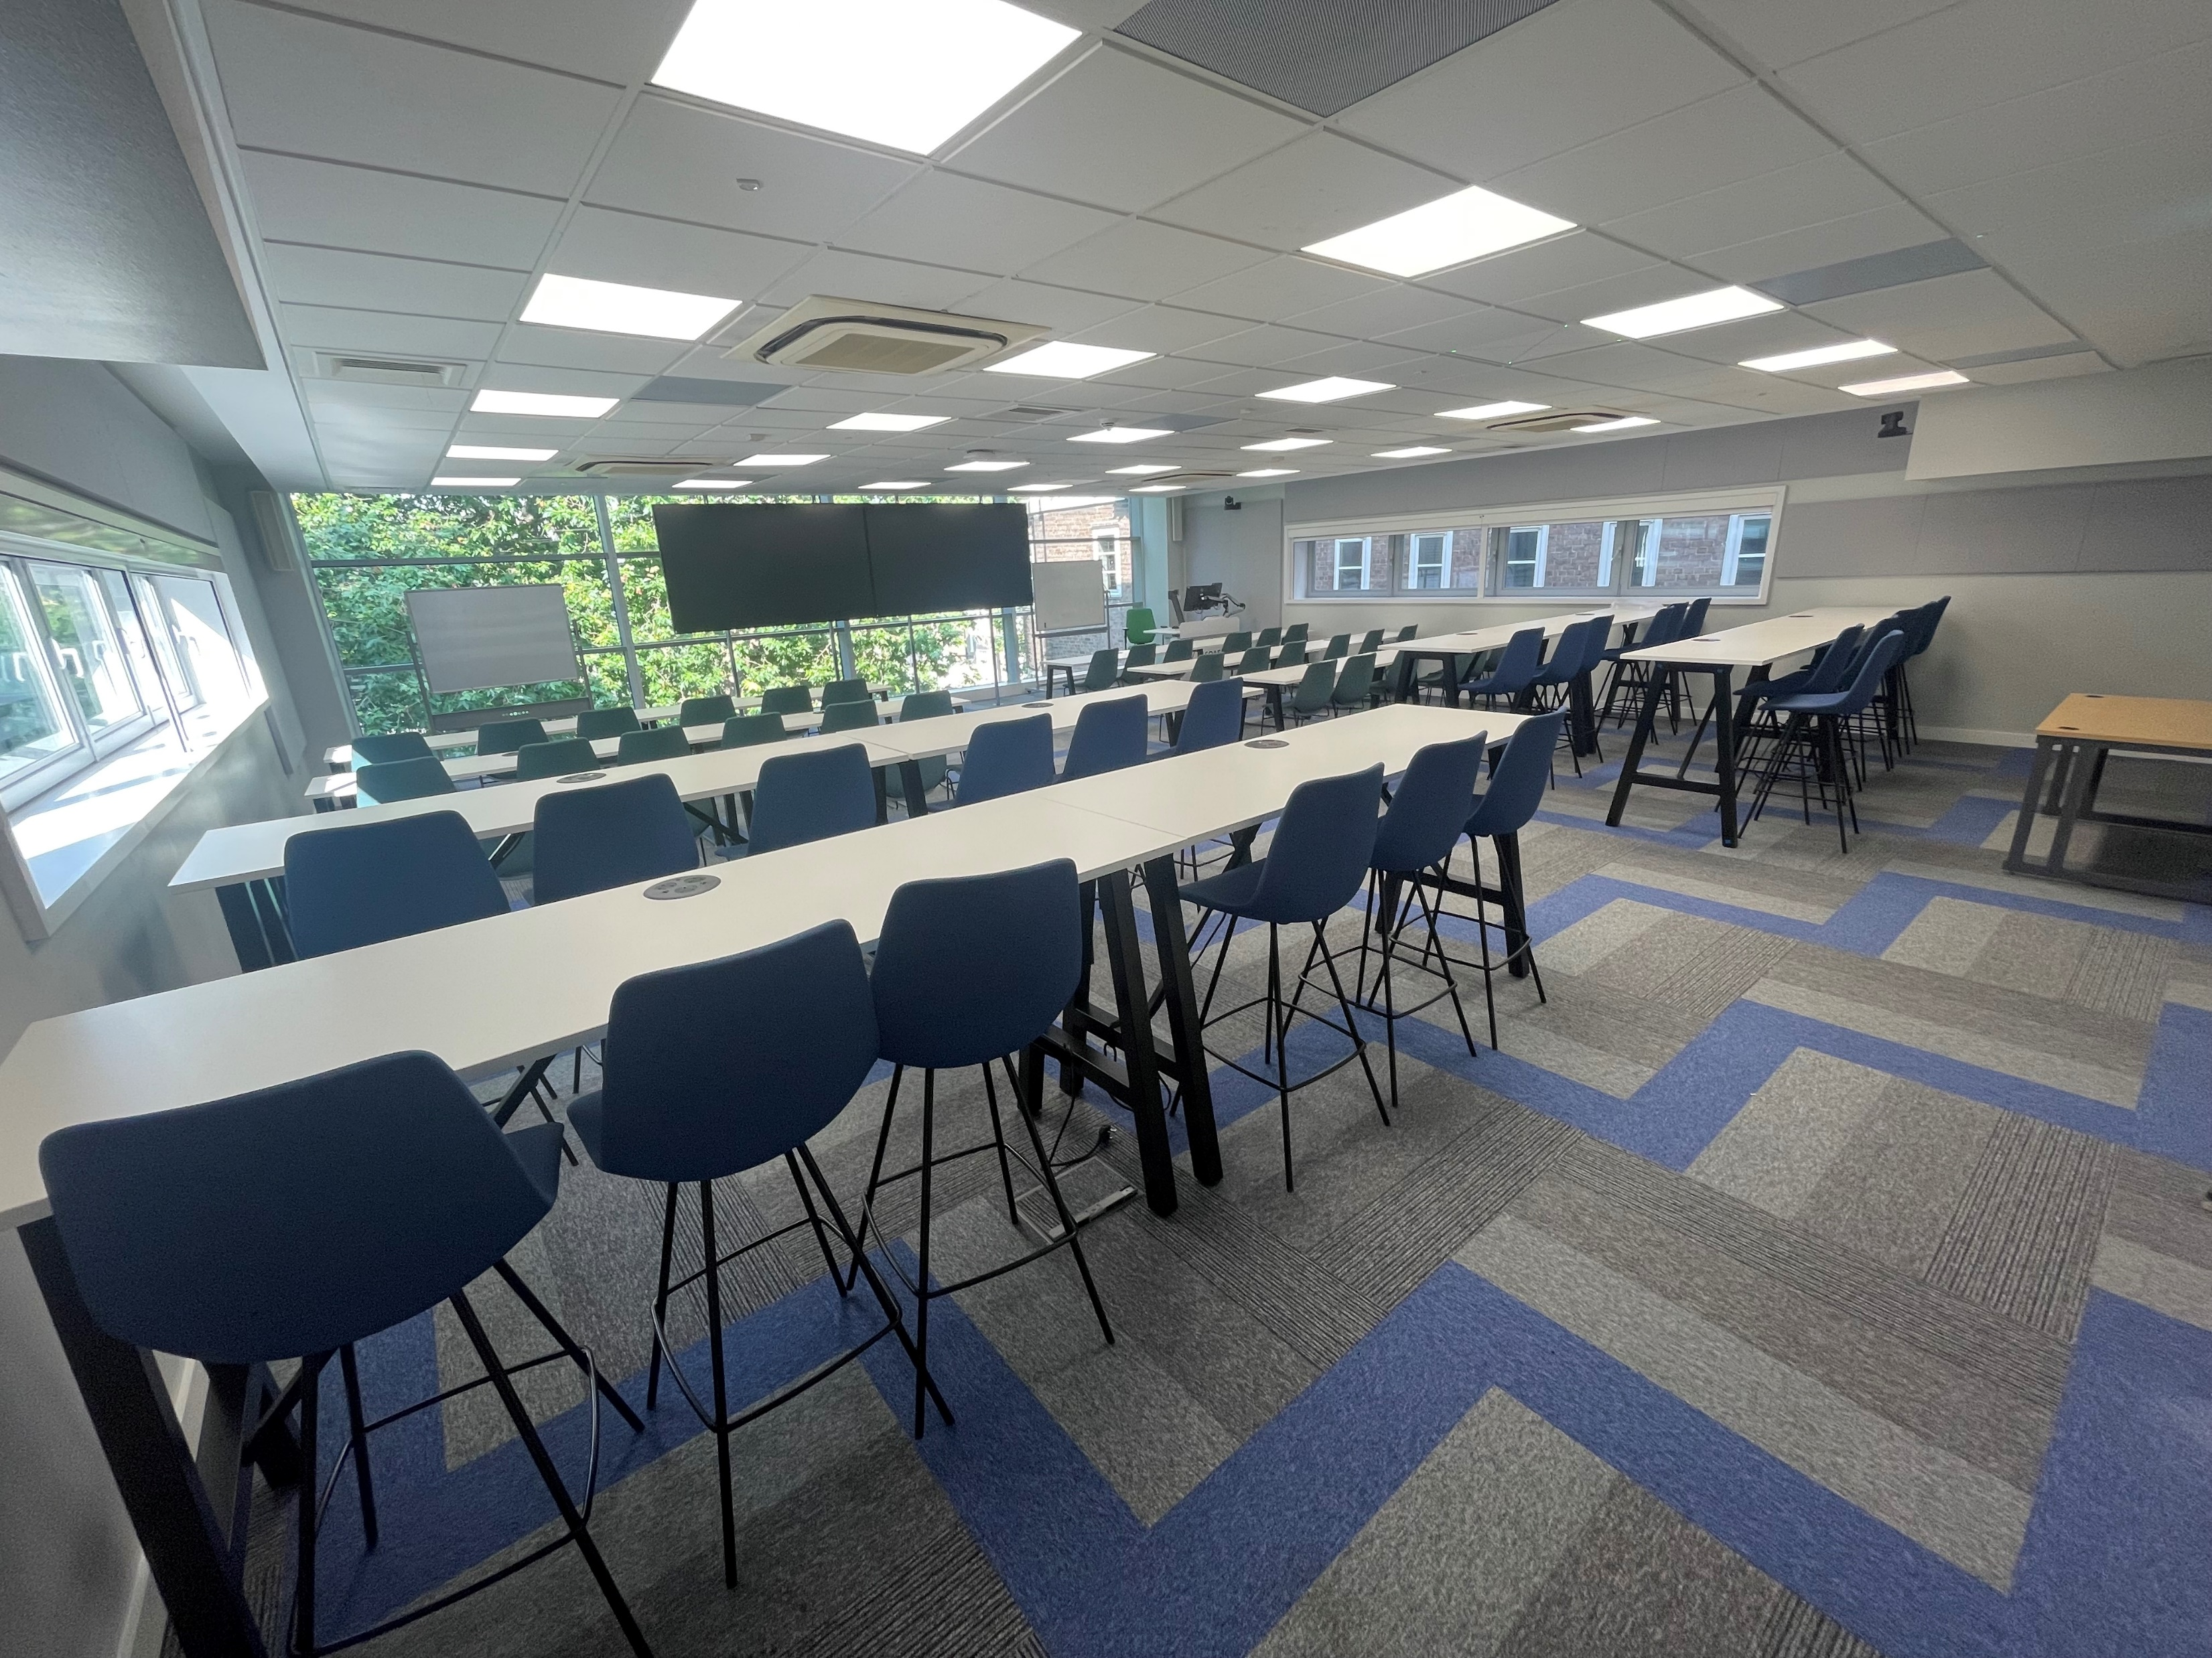

Slide 8
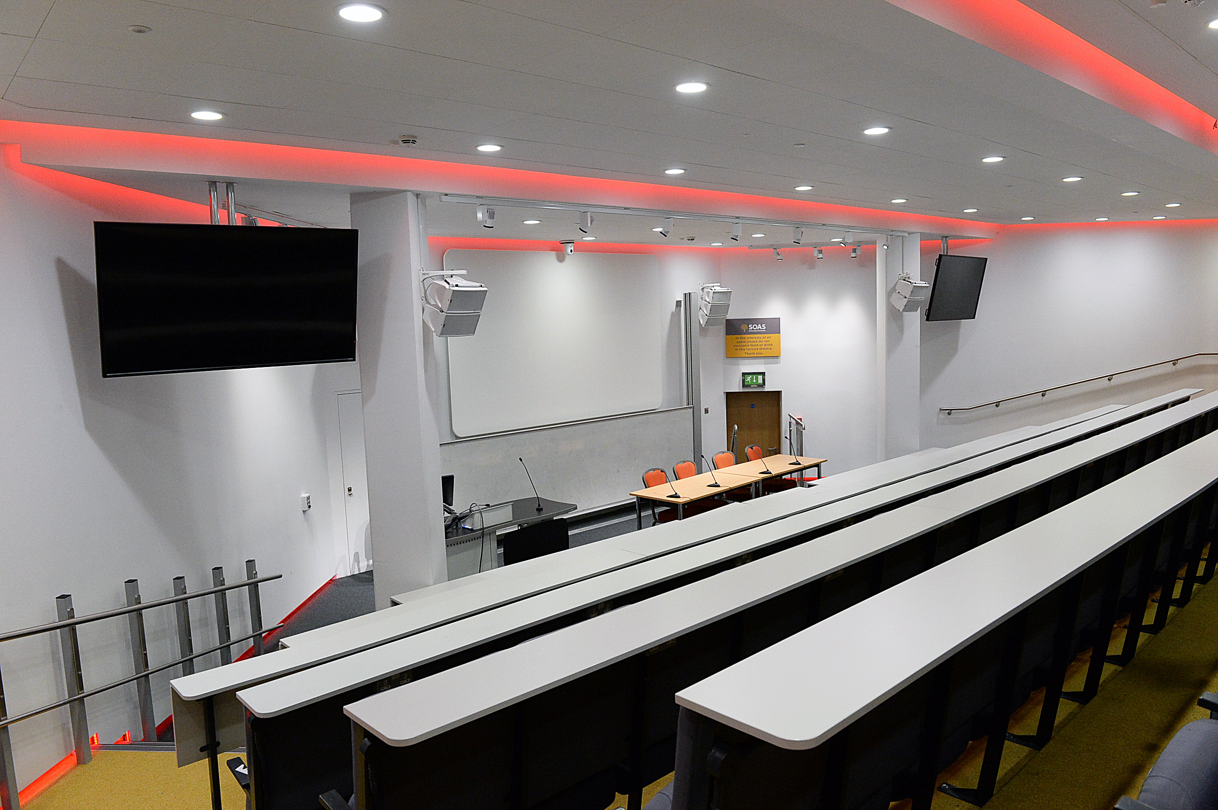
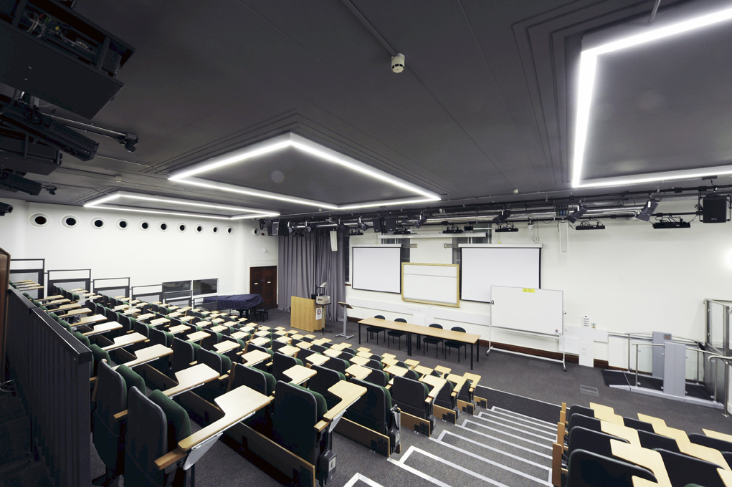
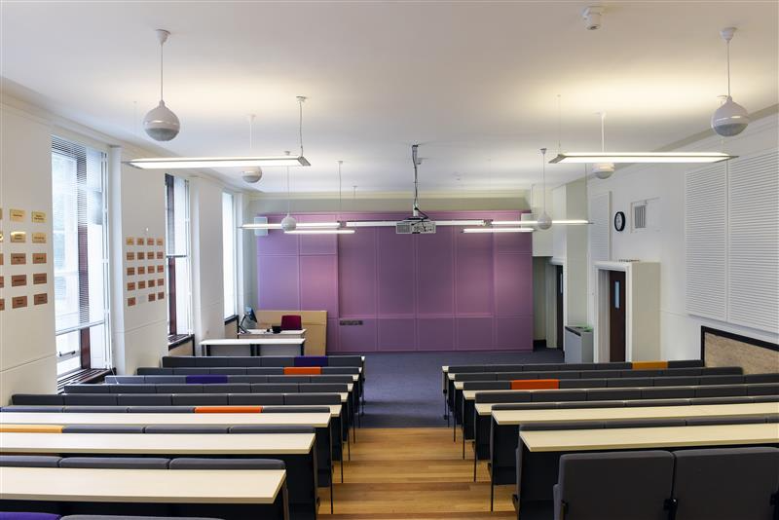
LECTURE THEATERS (80 to 140 guests)
TAGS:
LECTURE THEATRE
PRESENTATION
WORKSHOP
WORK SESSION
GROUP WORK
TRAINING ROOM
PRESENTATION
PLANNING SESSION
CREATIVE SPACE
ANNUAL GENERAL MEETING
SUMMIT
FORUM
SPEAKER PANNEL
PRESS CONFERENCE
CONFERENCE VENUE
AUDITORIUM
CONFERENCE CENTER
BOOK LAUNCHESS
FILM SCREENING
A modern lecture theatre for medium to large sized presentation lectures or workshops with a capacity up to 140 guests. The room is designed for conducting hybrid sessions. There is a foyer / adjacent room for registration / catering upon request. The room also includes: a whiteboard, guest Wi-Fi access as well as disabled access.
AV EQUIPMENT IN ROOM: HD laser projector / display screen, ceiling camera, gooseneck microphone, laptop HDMI interface, speakers
ADDITIONAL AV EQUIPMENT: roving handheld microphone

Slide 9
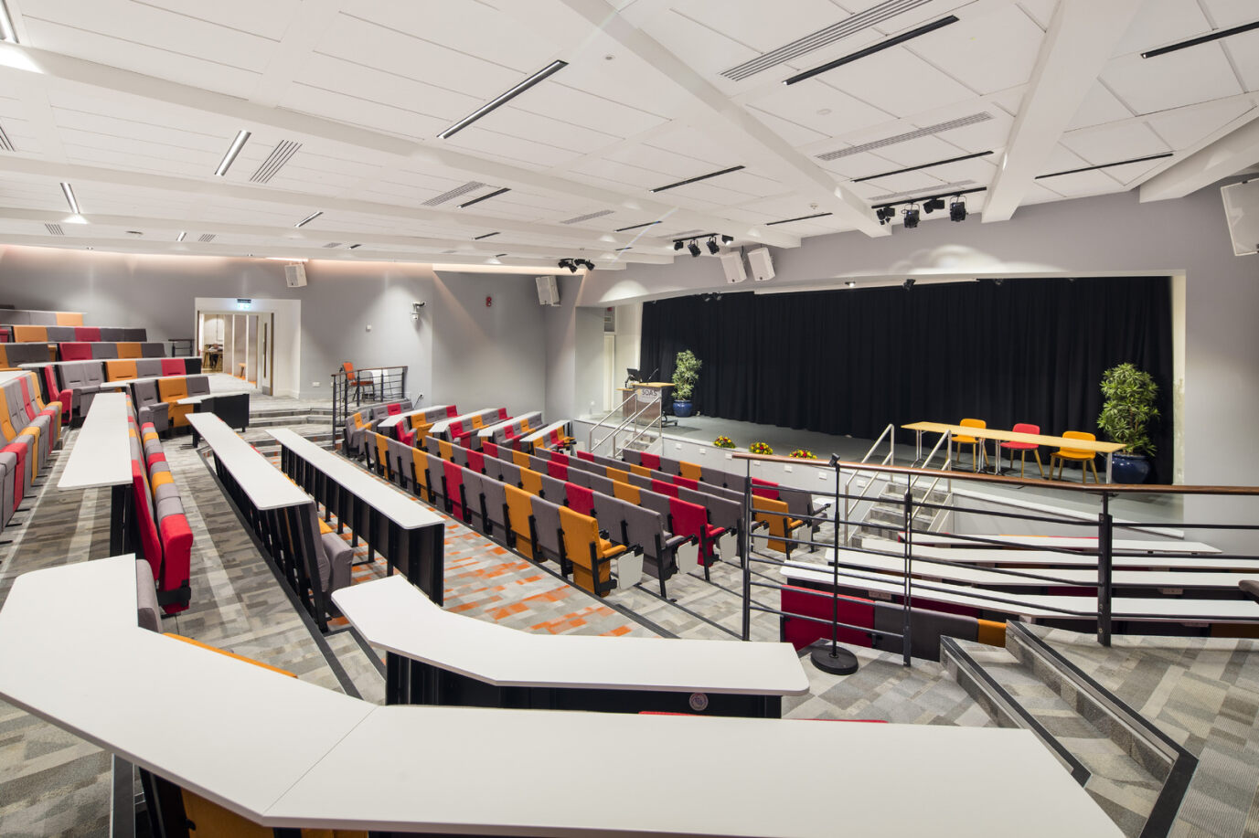
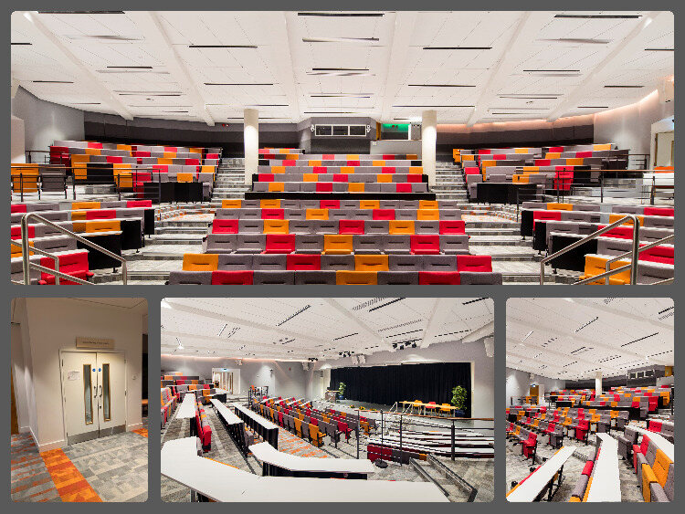
SOAS Gallery LECTURE THEATER (285 guests)
TAGS:
LECTURE THEATRE
PRESENTATION
WORKSHOP
WORK SESSION
GROUP WORK
TRAINING ROOM
PRESENTATION
PLANNING SESSION
CREATIVE SPACE
ANNUAL GENERAL MEETING
SUMMIT
FORUM
SPEAKER PANNEL
PRESS CONFERENCE
CONFERENCE VENUE
AUDITORIUM
CONFERENCE CENTER
BOOK LAUNCHESS
FILM SCREENING
A state of the art lecture theatre for concerts, drama, large sized presentation lectures with a capacity up to 285 guests. The room is featured with professional lighting and multi-channel customisible audio mixer for a range of performance and hybrid sessions. There is a foyer / adjacent room for registration / catering upon request. The room also includes: a whiteboard, guest Wi-Fi access as well as disabled access.
AV EQUIPMENT IN ROOM: professional lighting facilities, multi-channel professional audio mixer, real-time multi-camera switching control panels, a HD laser projector, ceiling cameras for presenter and audience, gooseneck lectern mic, table mics for panel discussion.
ADDITIONAL AV EQUIPMENT: roving handheld microphone

Slide 10
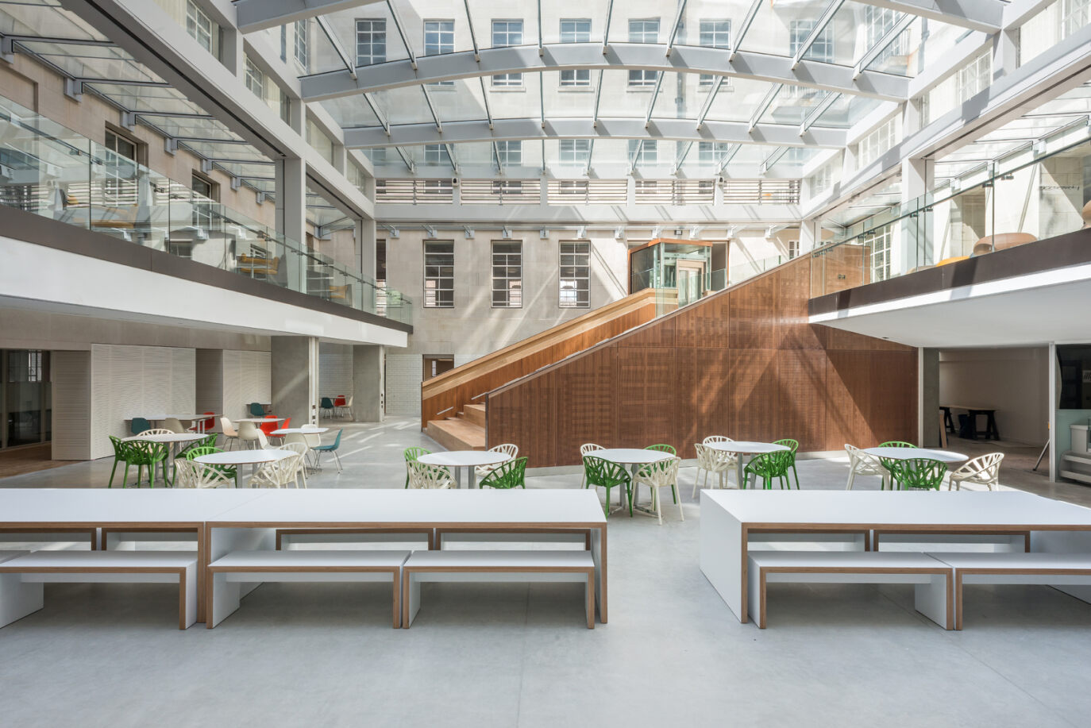
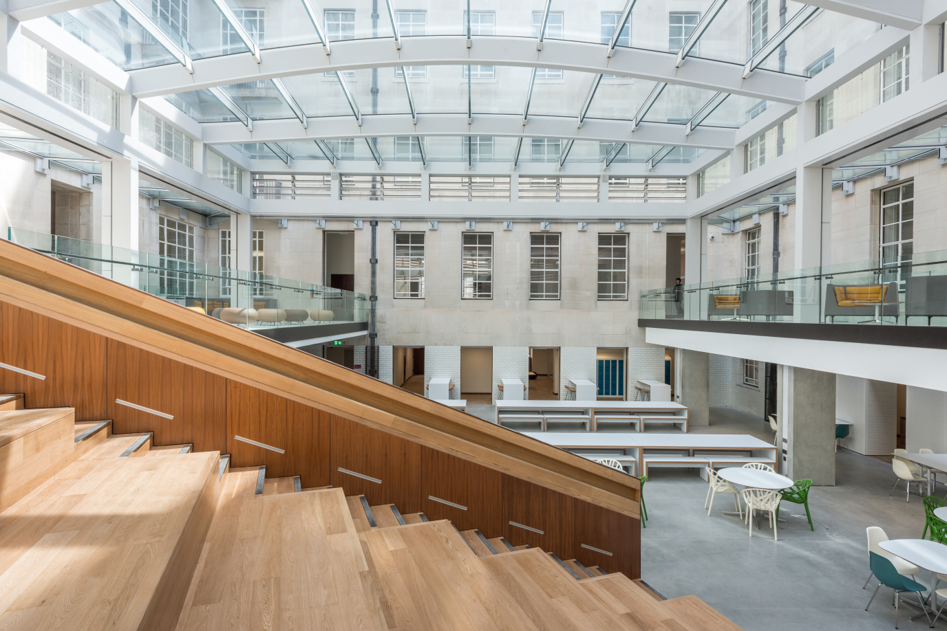
OPEN SPACES (20 to 1000 guests)
TAGS:
OPEN SPACE
FASHION SHOWS
PHOTOSHOOT
FILMING
EXHIBITIONS
BOOK LAUNCHESS
PRESENTATION
WORKSHOP
WORK SESSION
GROUP WORK
PLANNING SESSION
CREATIVE SPACE
ANNUAL GENERAL MEETING
SUMMIT
FORUM
PRESS CONFERENCE
CONFERENCE VENUE
AUDITORIUM
CONFERENCE CENTER
It features a large skylight that floods the space with natural light, and a dedicated entrance and reception. It is highly versatile and is ideal for conferences, AGMs, graduations, product launches and movie shoots & more.
AV EQUIPMENT IN ROOM: portable speaker with wired microphone and mic stand, 90 inch display screen
ADDITIONAL AV EQUIPMENT: (add cost) none

Slide 11
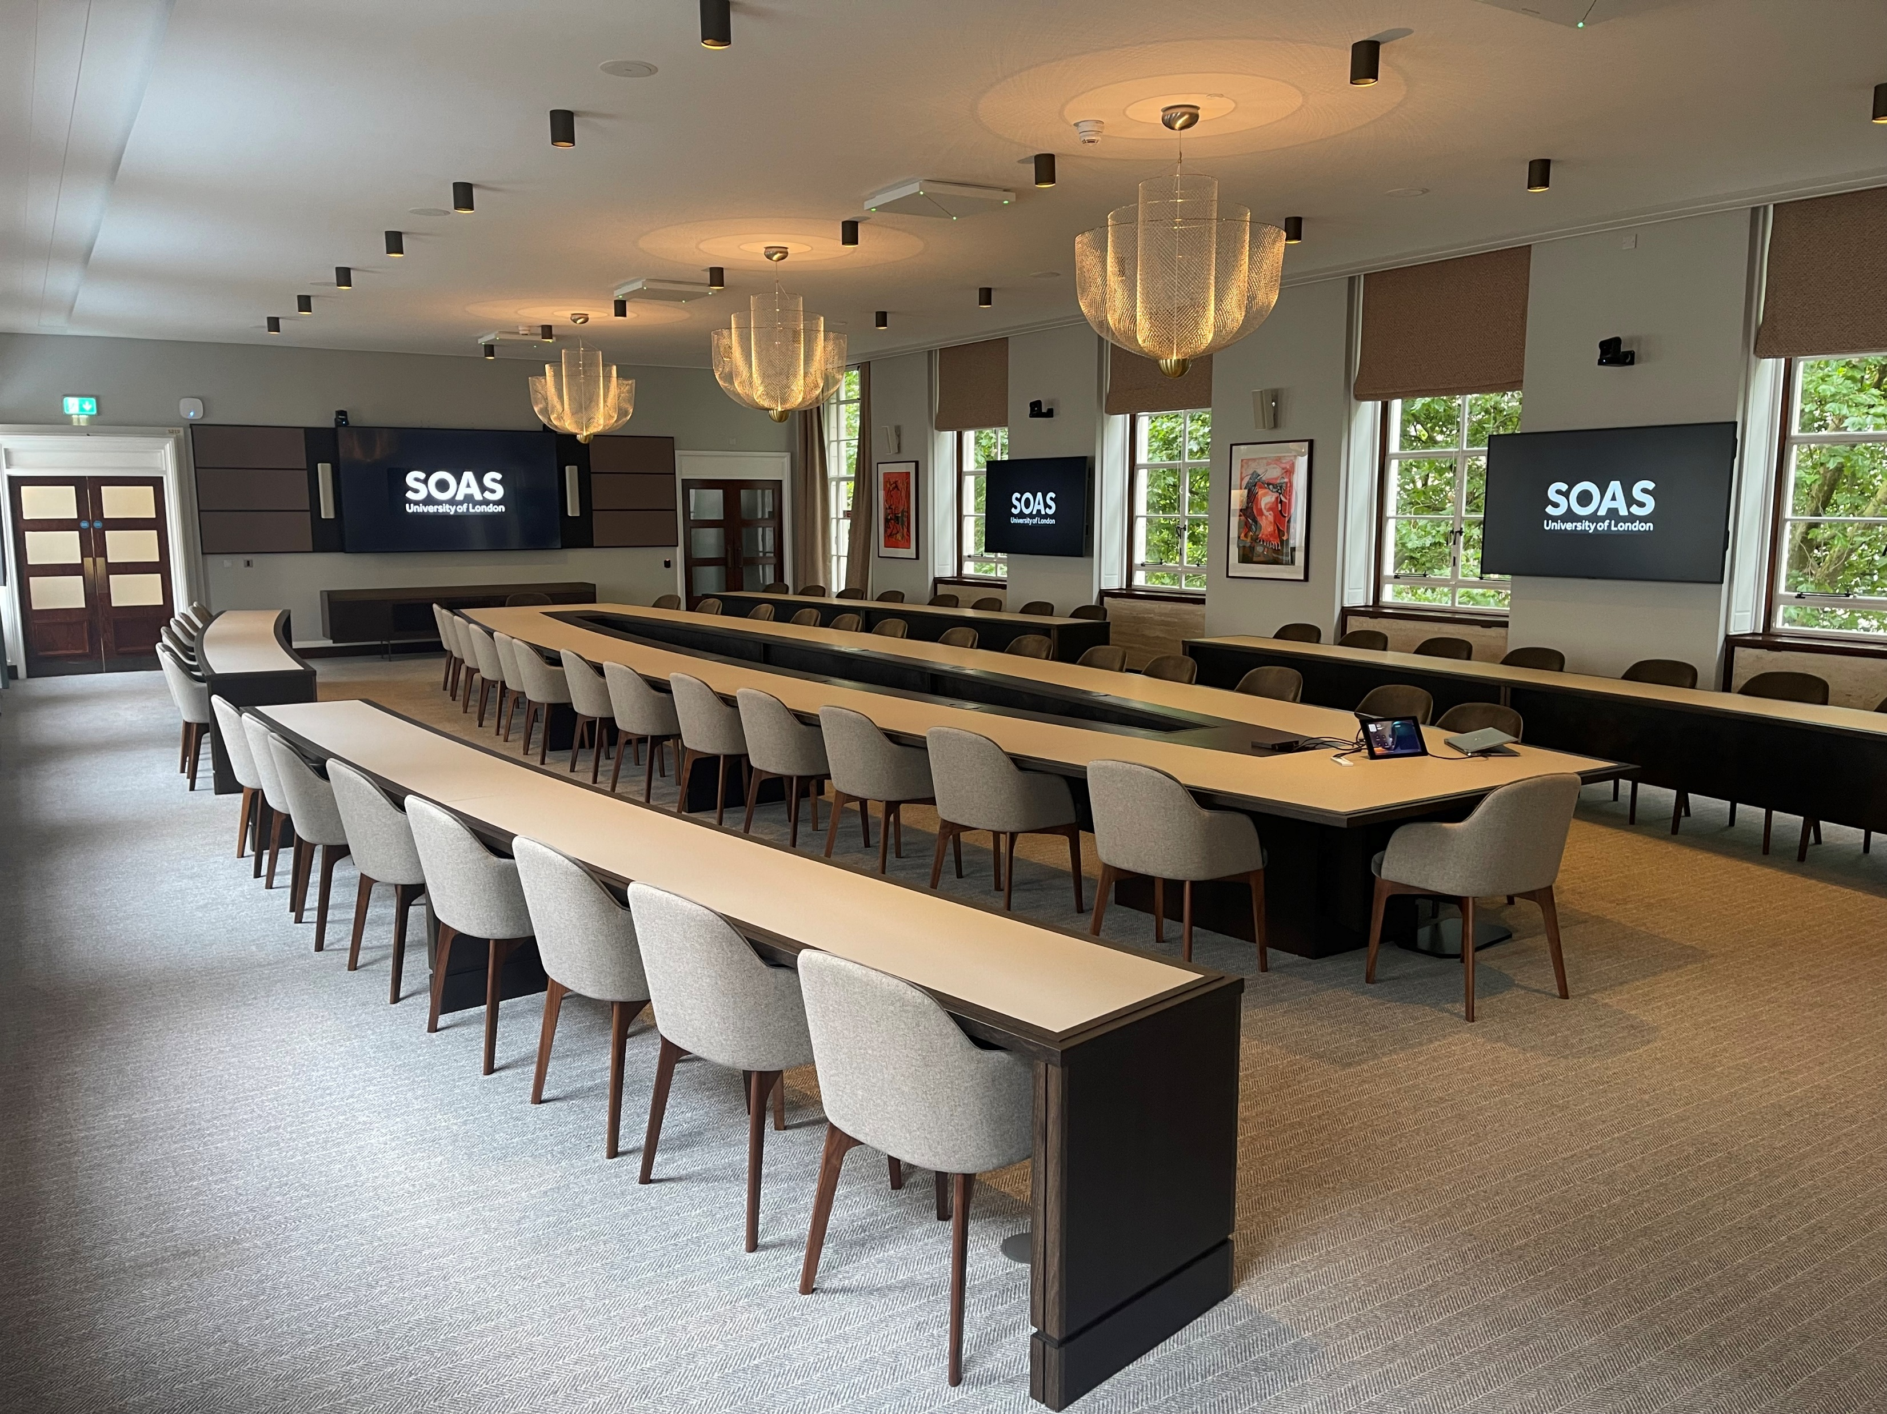
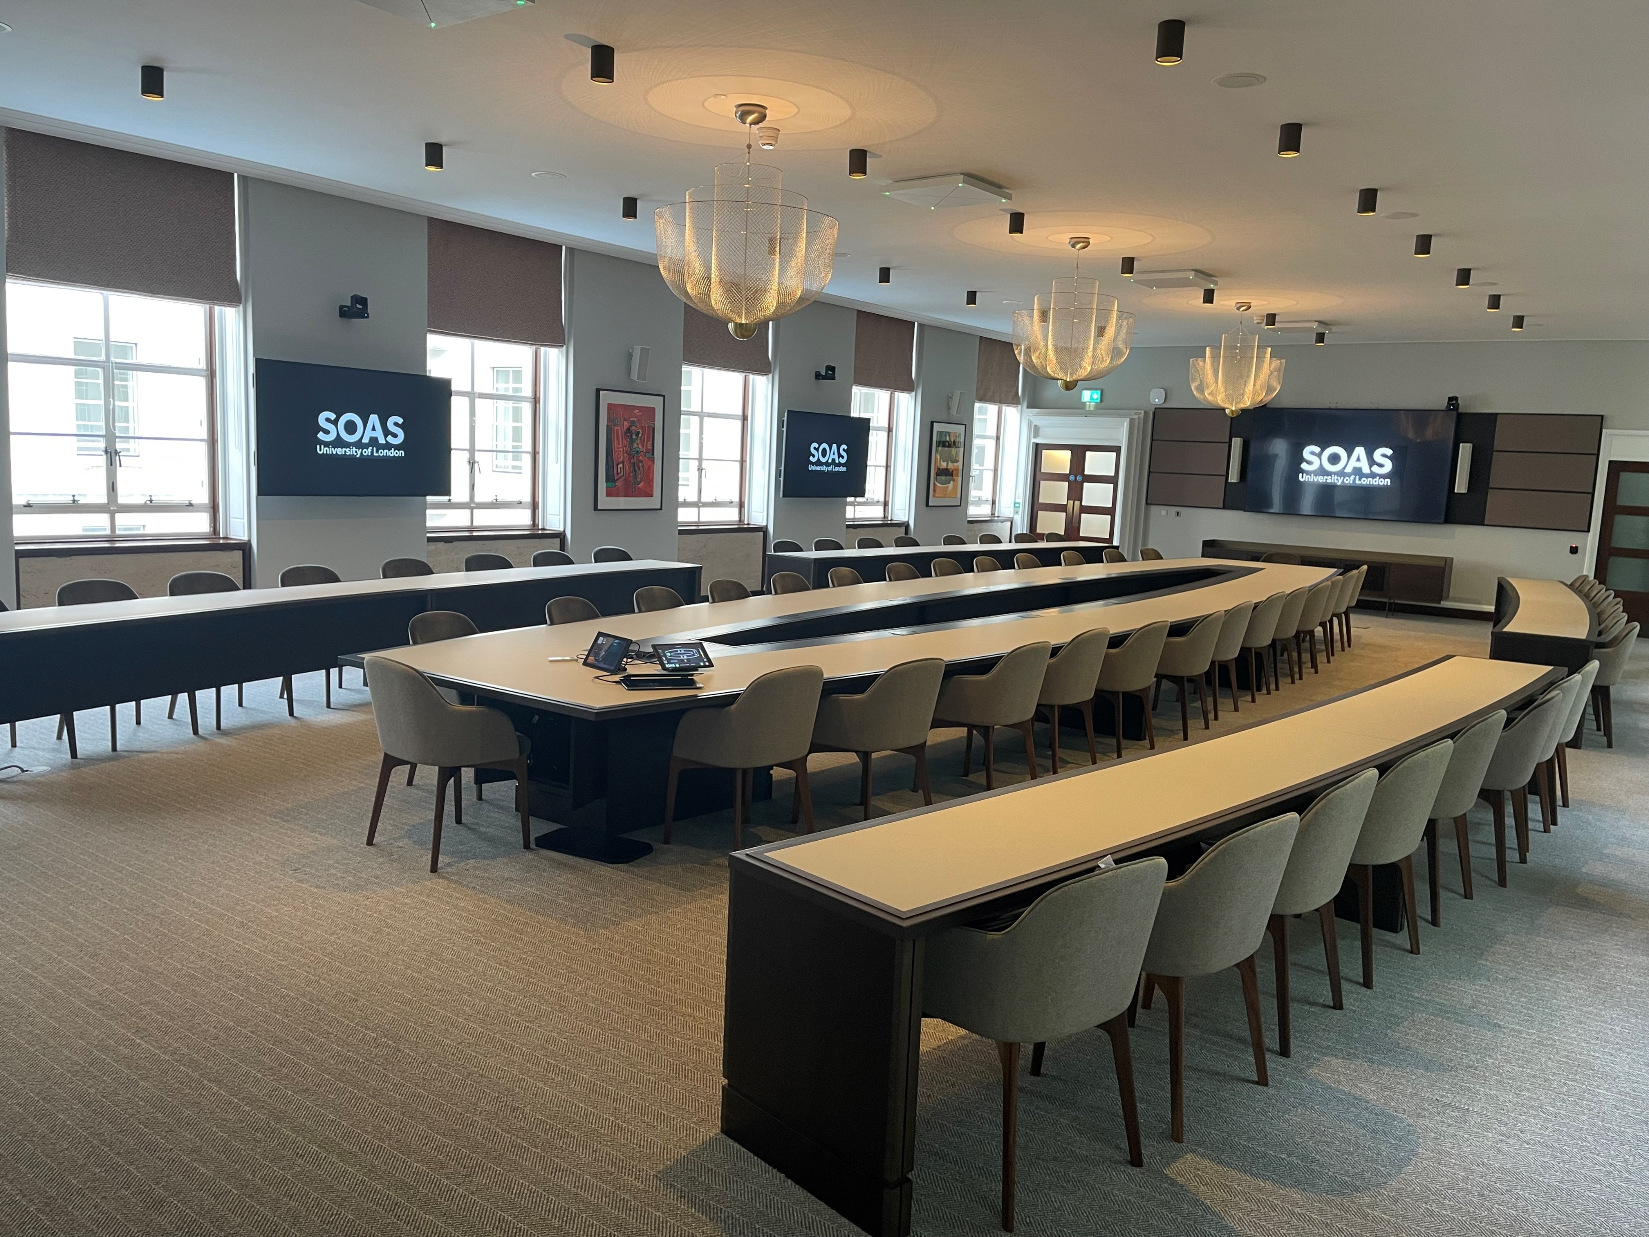
BOARDROOM (up to 60 guests)
TAGS:
BOARDROOM
PRESENTATION
WORKSHOP
ADVANCE AV
PREMIUM SPACE
BOOK LAUNCHESS
PRESENTATION
WORKSHOP
WORK SESSION
GROUP WORK
PLANNING SESSION
CREATIVE SPACE
ANNUAL GENERAL MEETING
SUMMIT
FORUM
PRESS CONFERENCE
CONFERENCE VENUE
BOOK LAUNCHES
FILM SCREENING
State of the art board room perfectly designed and dedicated to meetings, conferences and training center. The room is filled with natural daylight and equipped with built in AV.
AV EQUIPMENT IN ROOM: display screen, ceiling microphones, state of the art auto-tracking ceiling cameras, Microsoft Teams Room, speakers

Slide 12
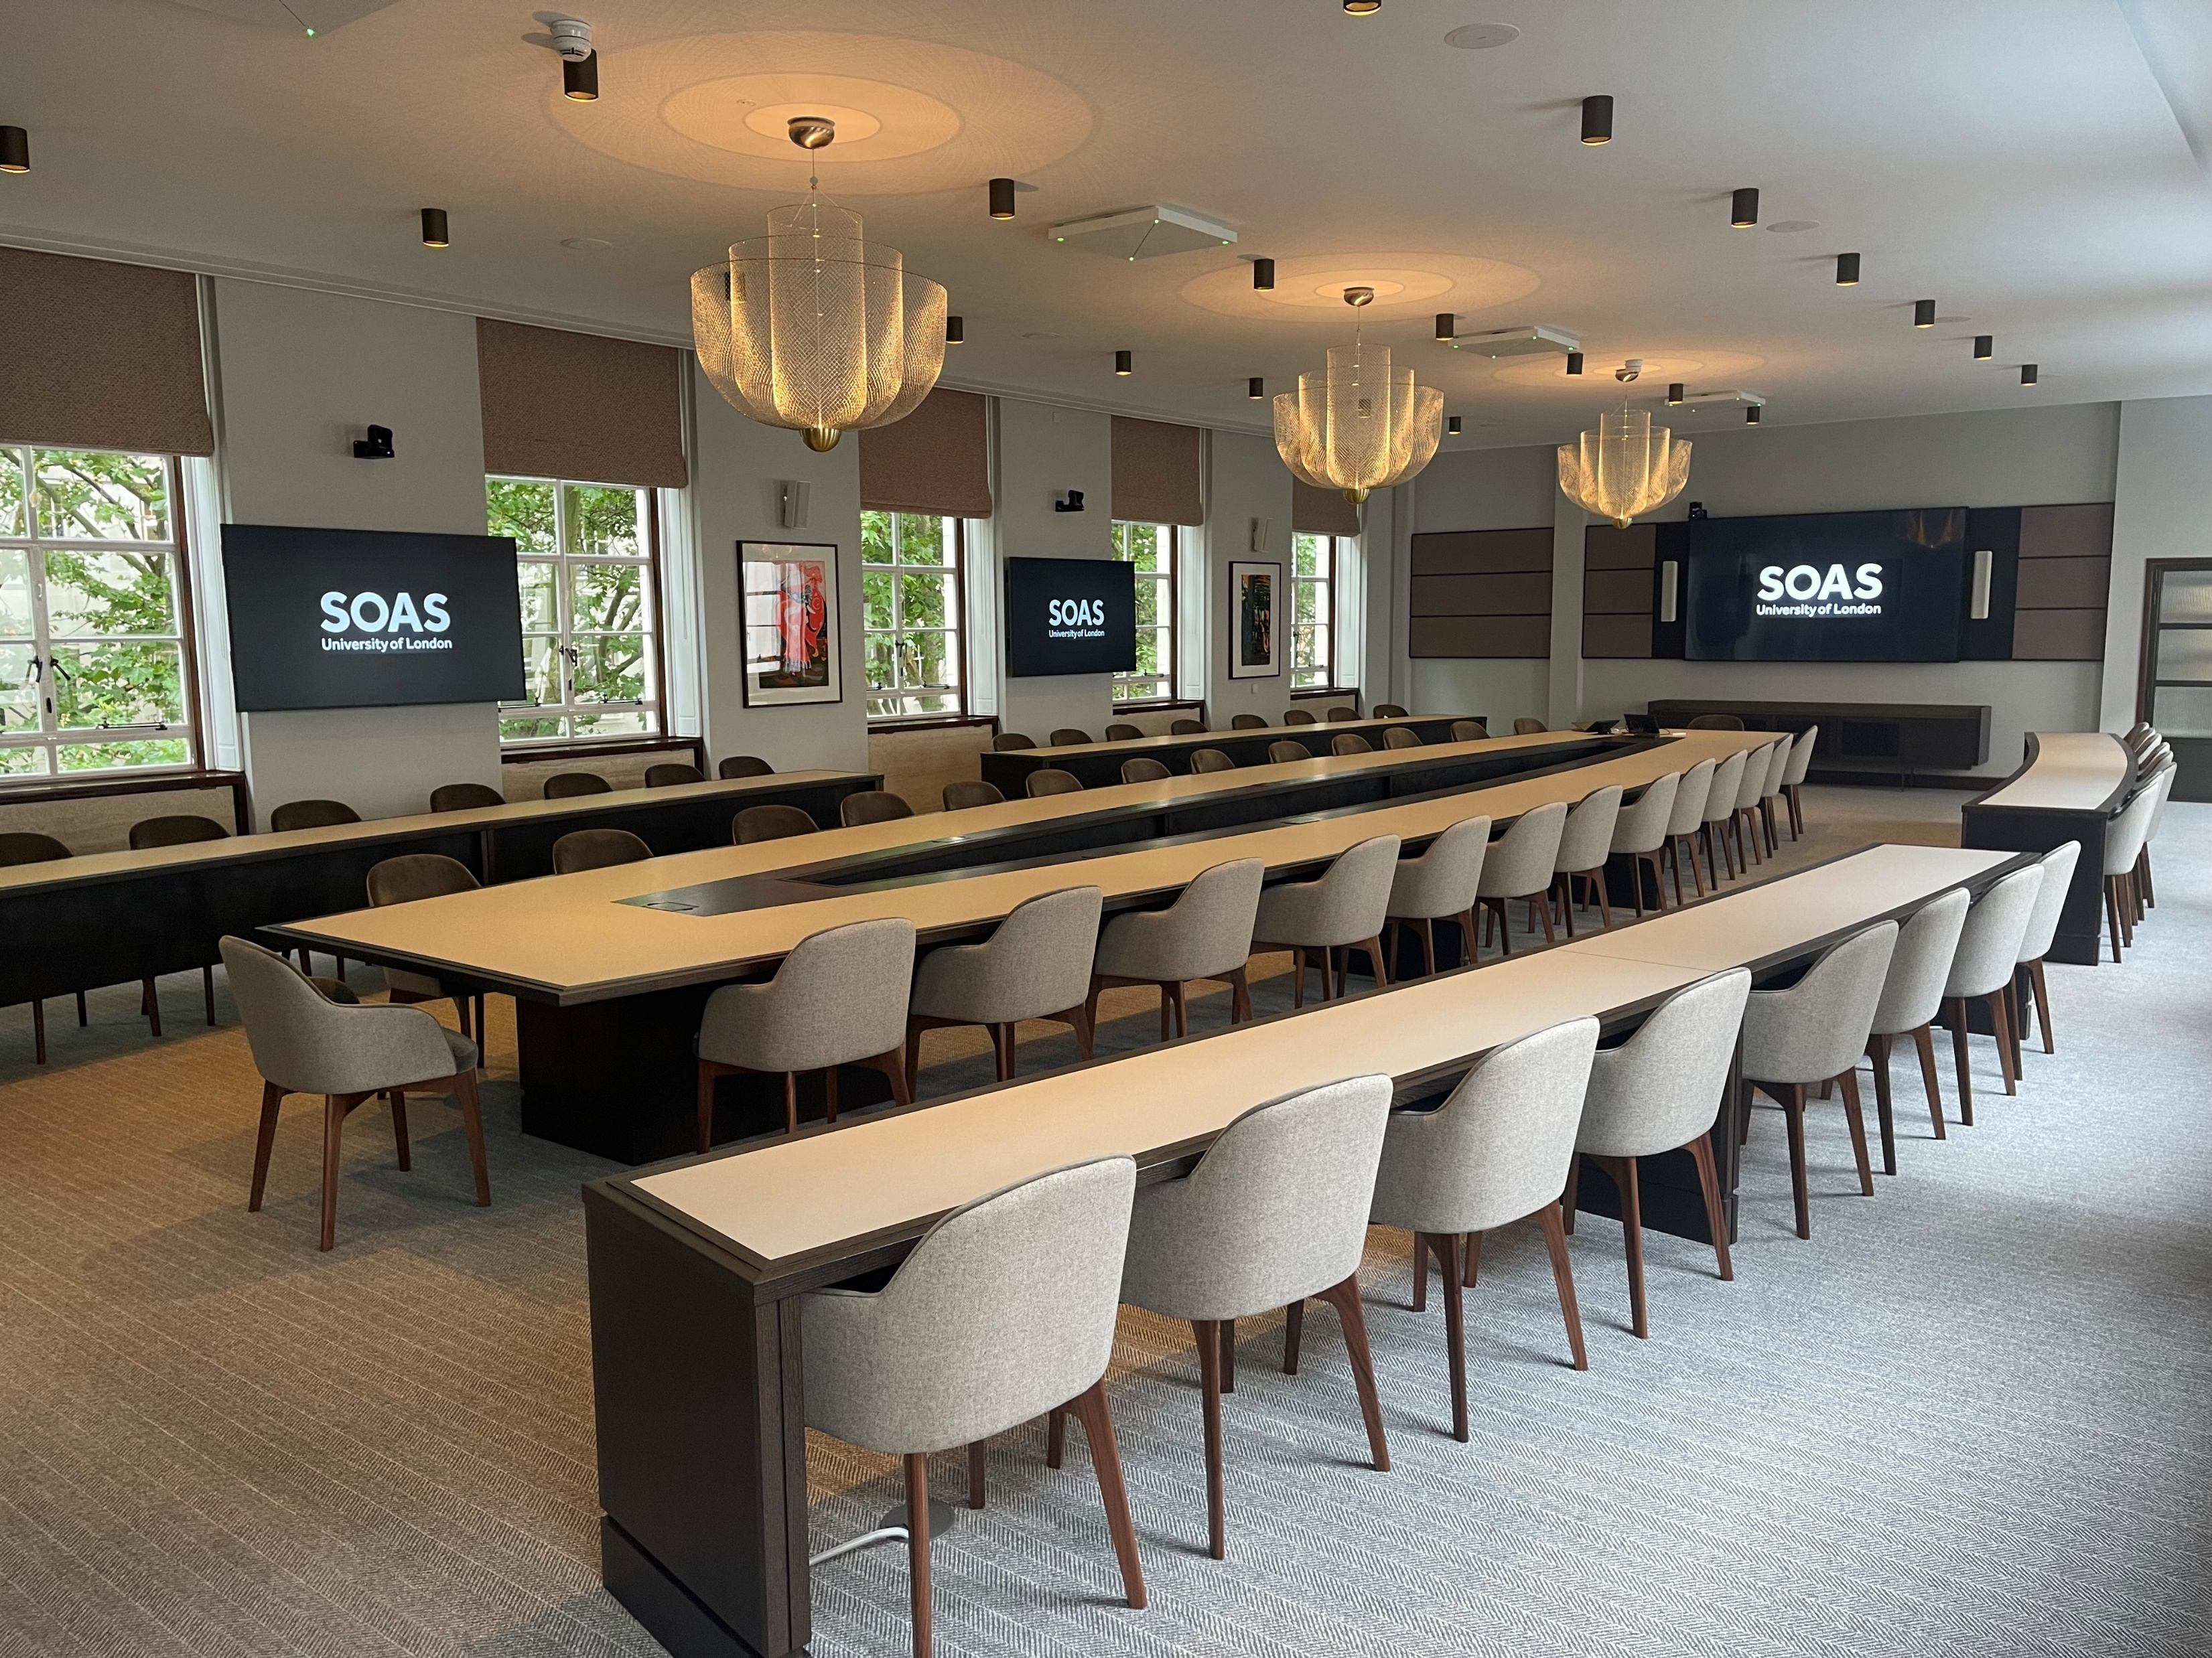

Slide 13
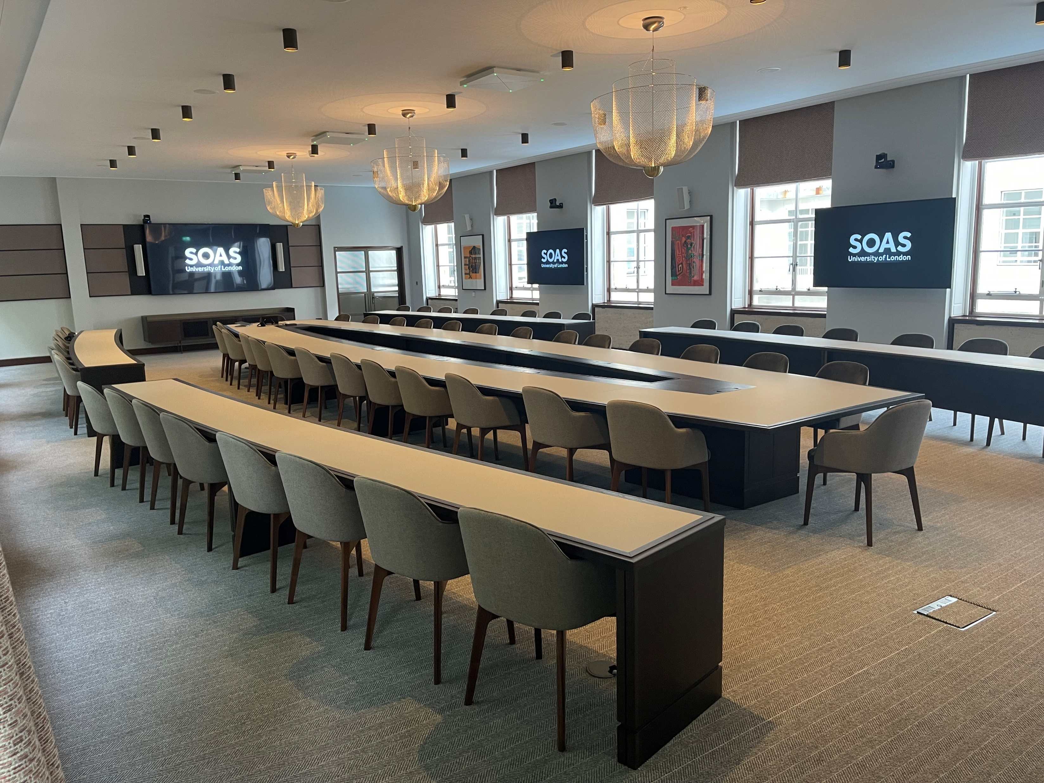

Slide 14
SERVICES
We provide a comprehensive range of services designed to elevate the guest experience and ensure seamless event execution. Our offerings include:
Catering & Hospitality – Exceptional food and beverage service tailored to your event’s needs.
Portering – Efficient support for setup, logistics, and smooth transitions.
Welcoming Team / Hosts / Cloakroom Attendants – Professional and friendly staff to create a warm and organized arrival experience.
AV Technicians – Expert assistance in managing audio-visual elements for flawless presentations and performances.
Safety Officers / Personal Security – Dedicated personnel ensuring a secure and well-managed environment.

Slide 15
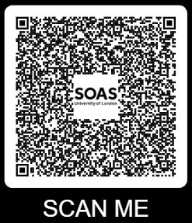
CONTACT US
Email: 📧
roombooking@soas.ac.uk
hospitality@soas.ac.uk
Phone: 📞
+44 02078984896
+44 02078984805

